Slide 1
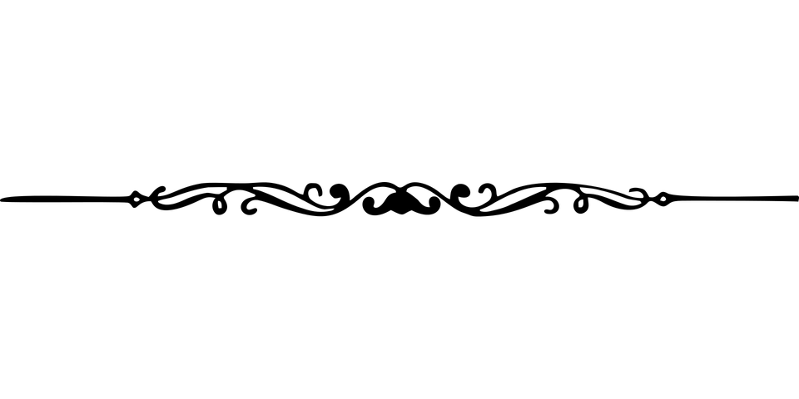
Data presentation
Clamshell Project
23 December 2019
José Pereira

Slide 2

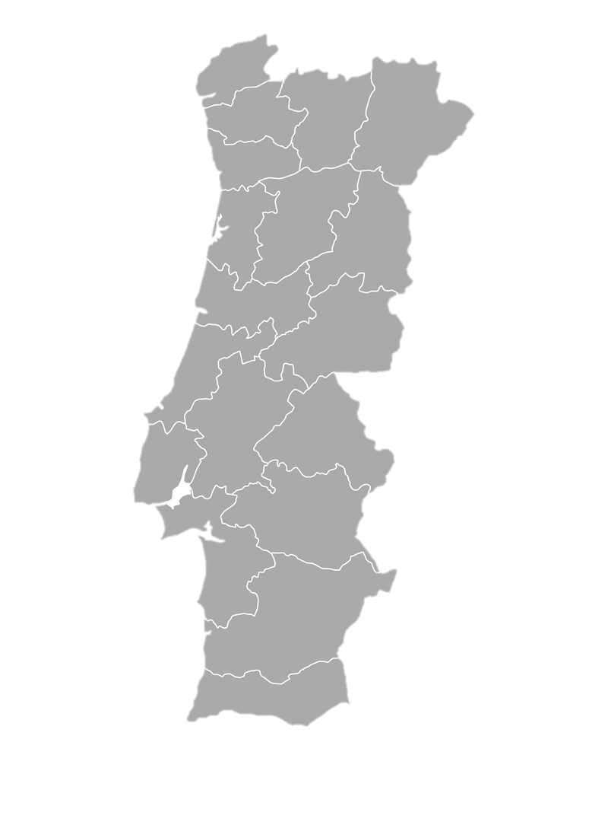
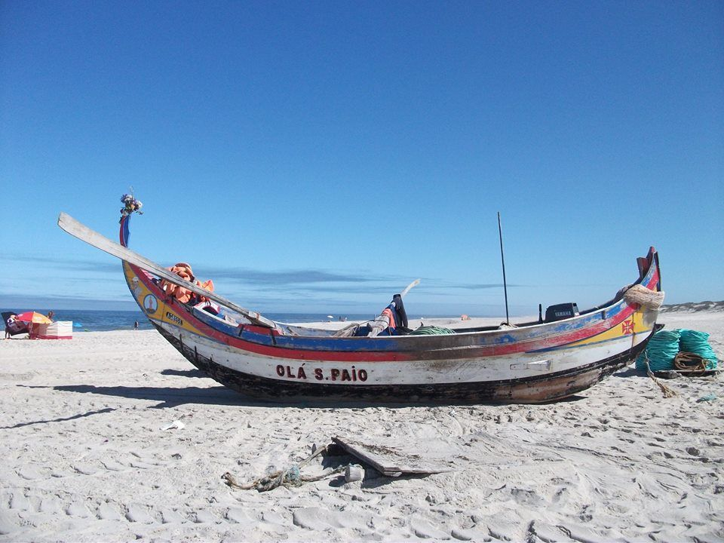
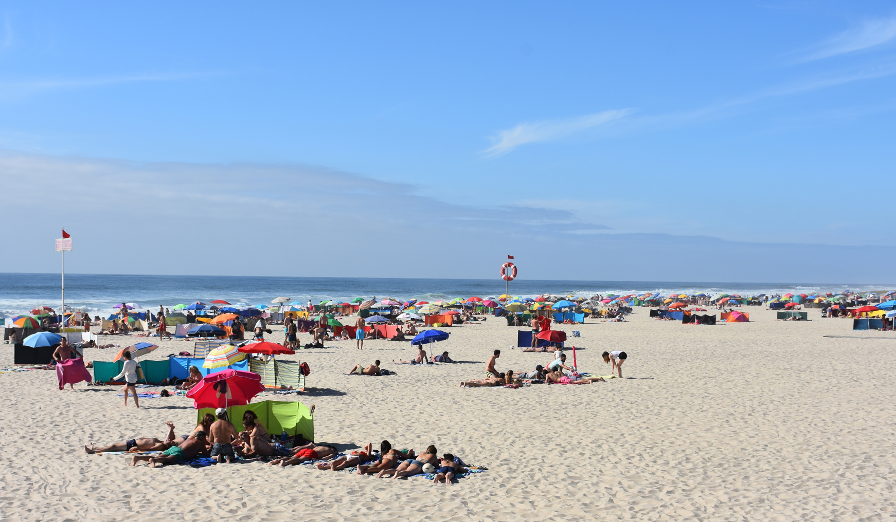

Slide 3
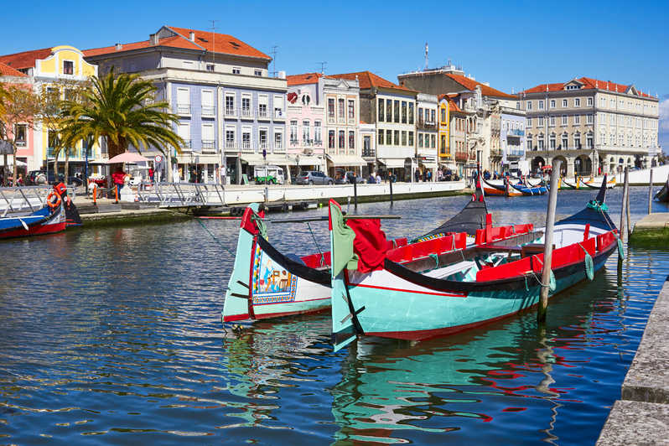
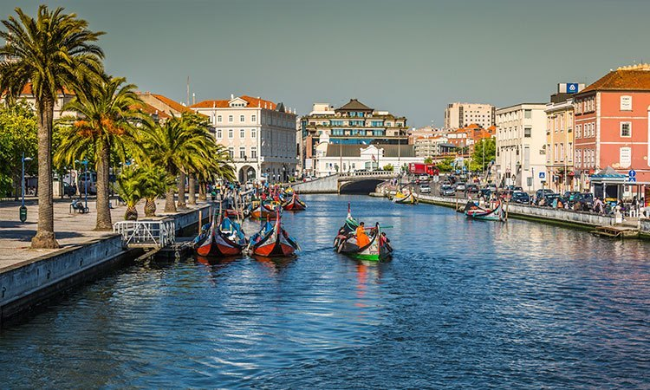
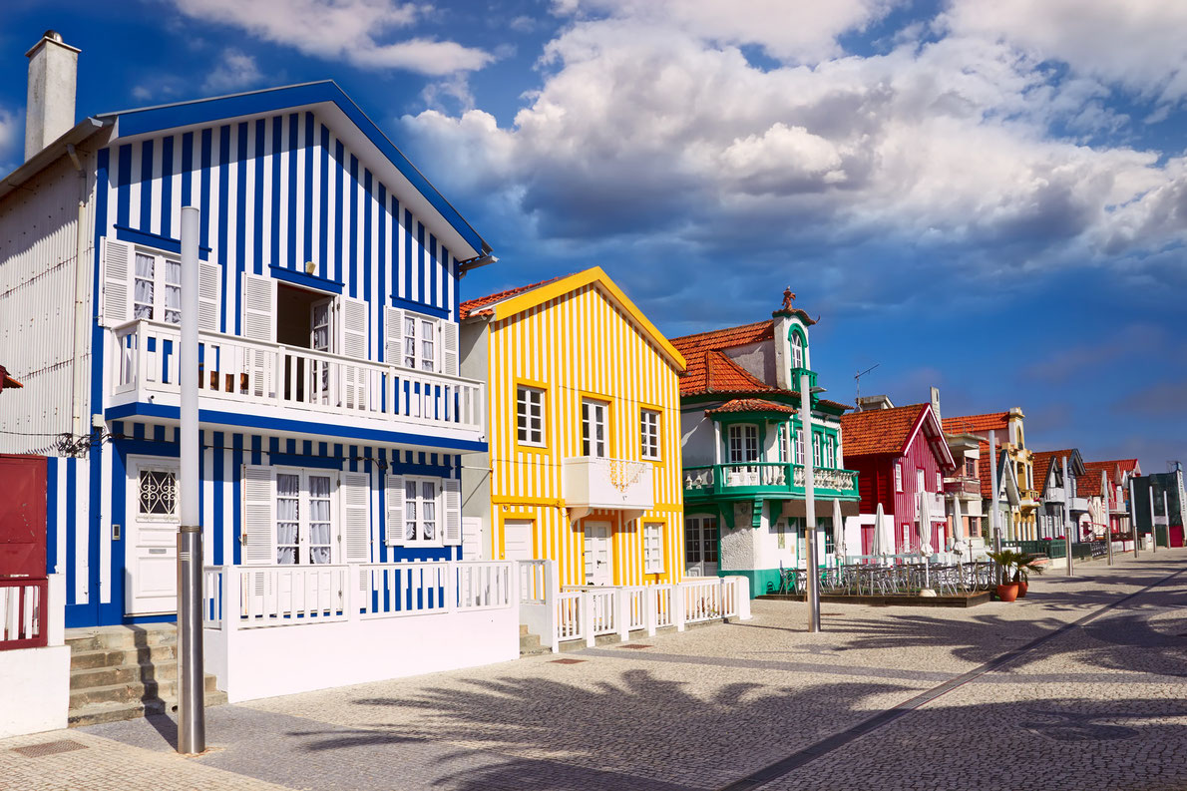

Slide 4
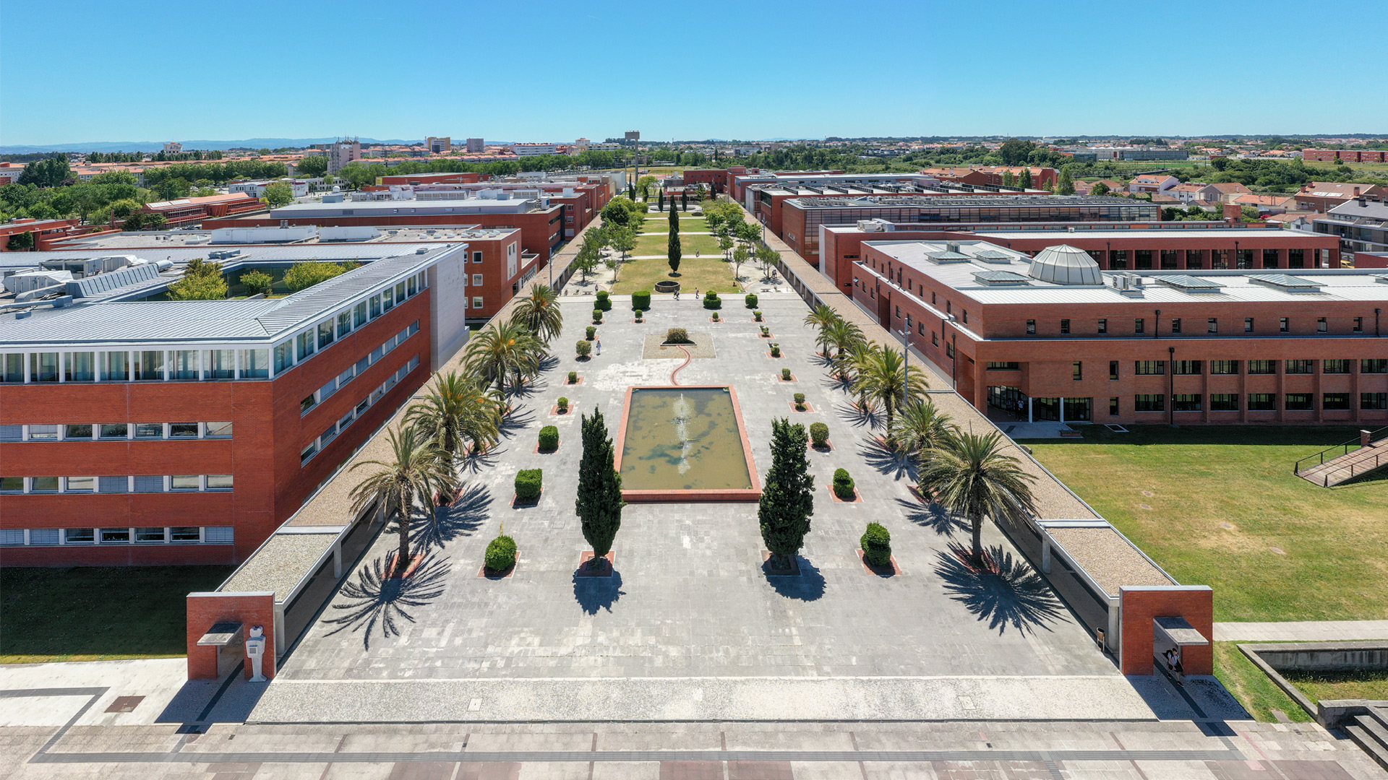
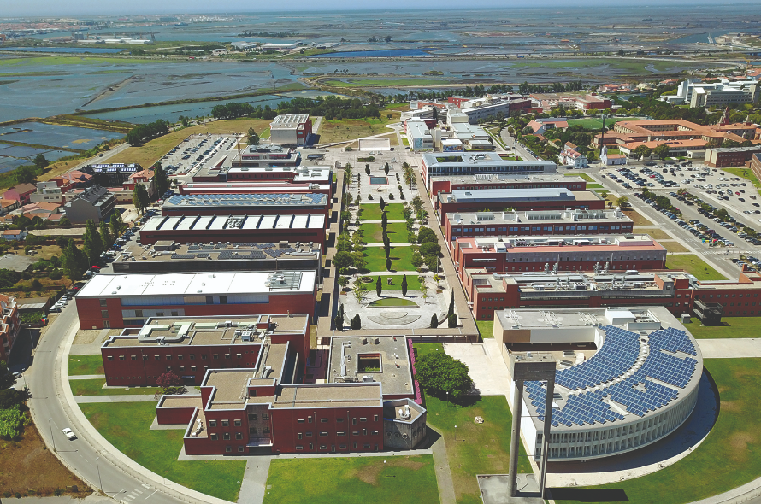

Slide 5
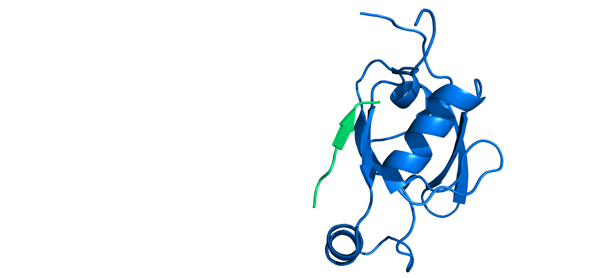
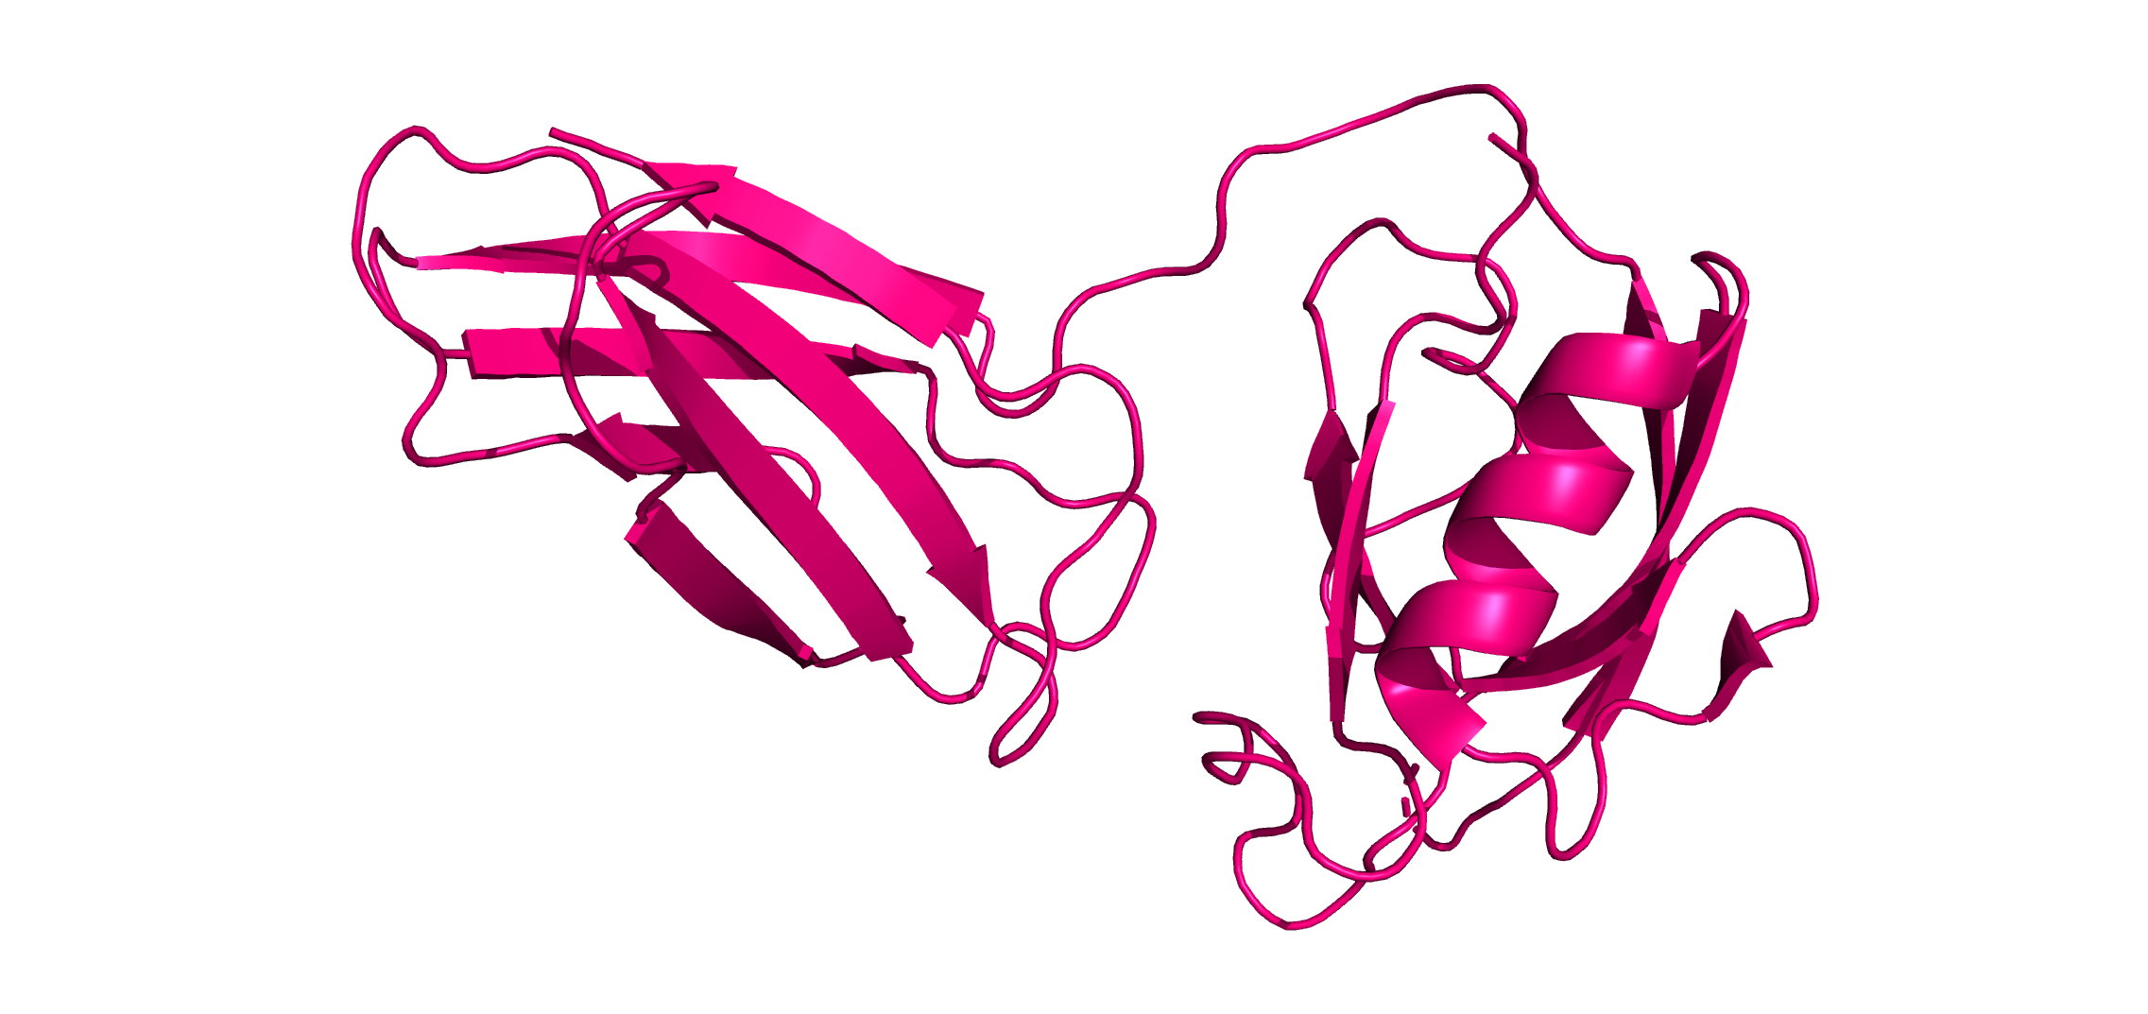
Objective
The HTra1 protease is highly promiscuous, so we intend to improve specificity towards alpha synuclein.
+
3CH8
The clamp is the Fibronectin II (FN3) domain.
2JOA
The new PDZ domain is the C terminus of Htra1 protease.

Slide 6
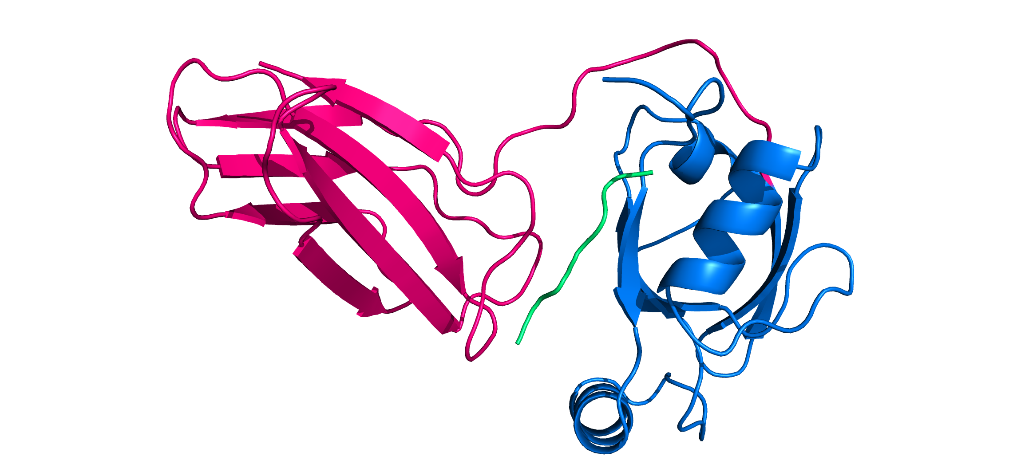
Objective
The HTra1 protease is highly promiscuous, so we intend to improve specificity towards alpha synuclein.
Proposed Clamshell
This placement was obtained simply by alignment with the original PDZ domain.

Slide 7
The project so far
Initial structure
Relaxation
Fixed Backbone Design
Pseudo Docking Design
+
Re-loop Design

Slide 8
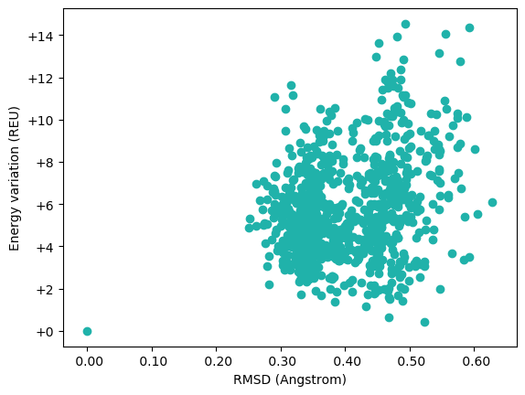
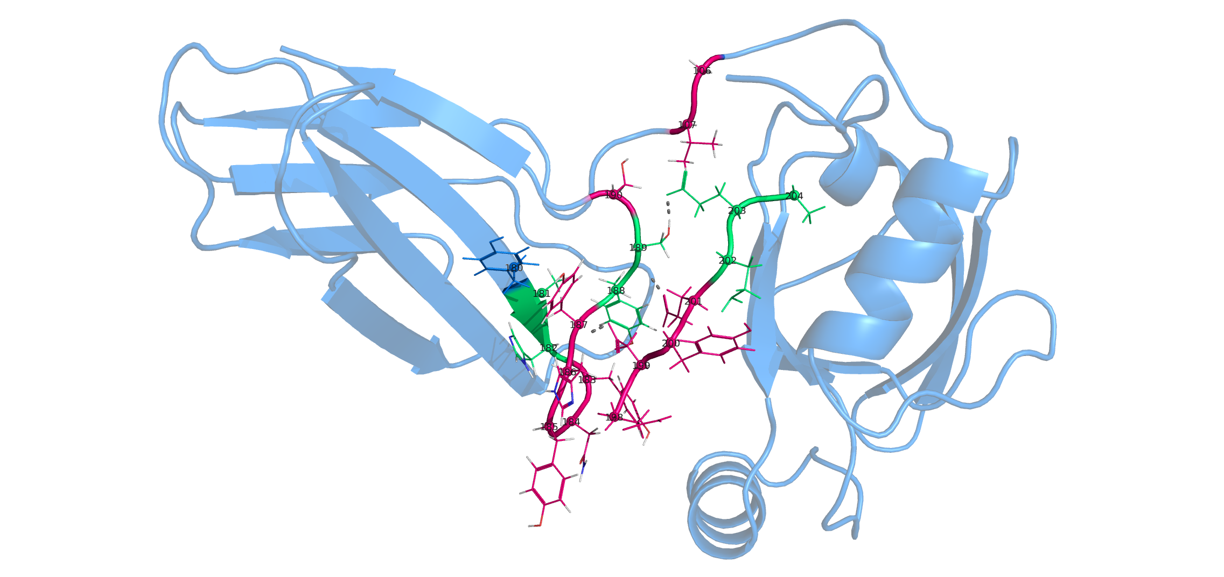
1. Relaxation
1000 clamshell decoys
relax_570.pdb

Slide 9
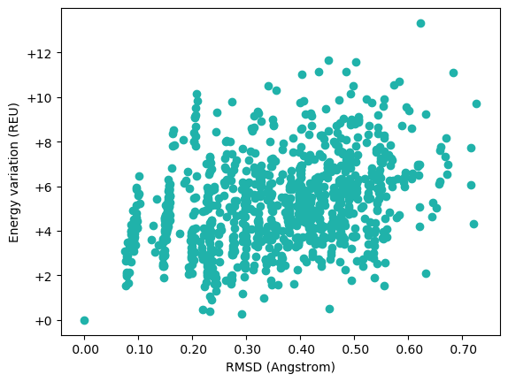
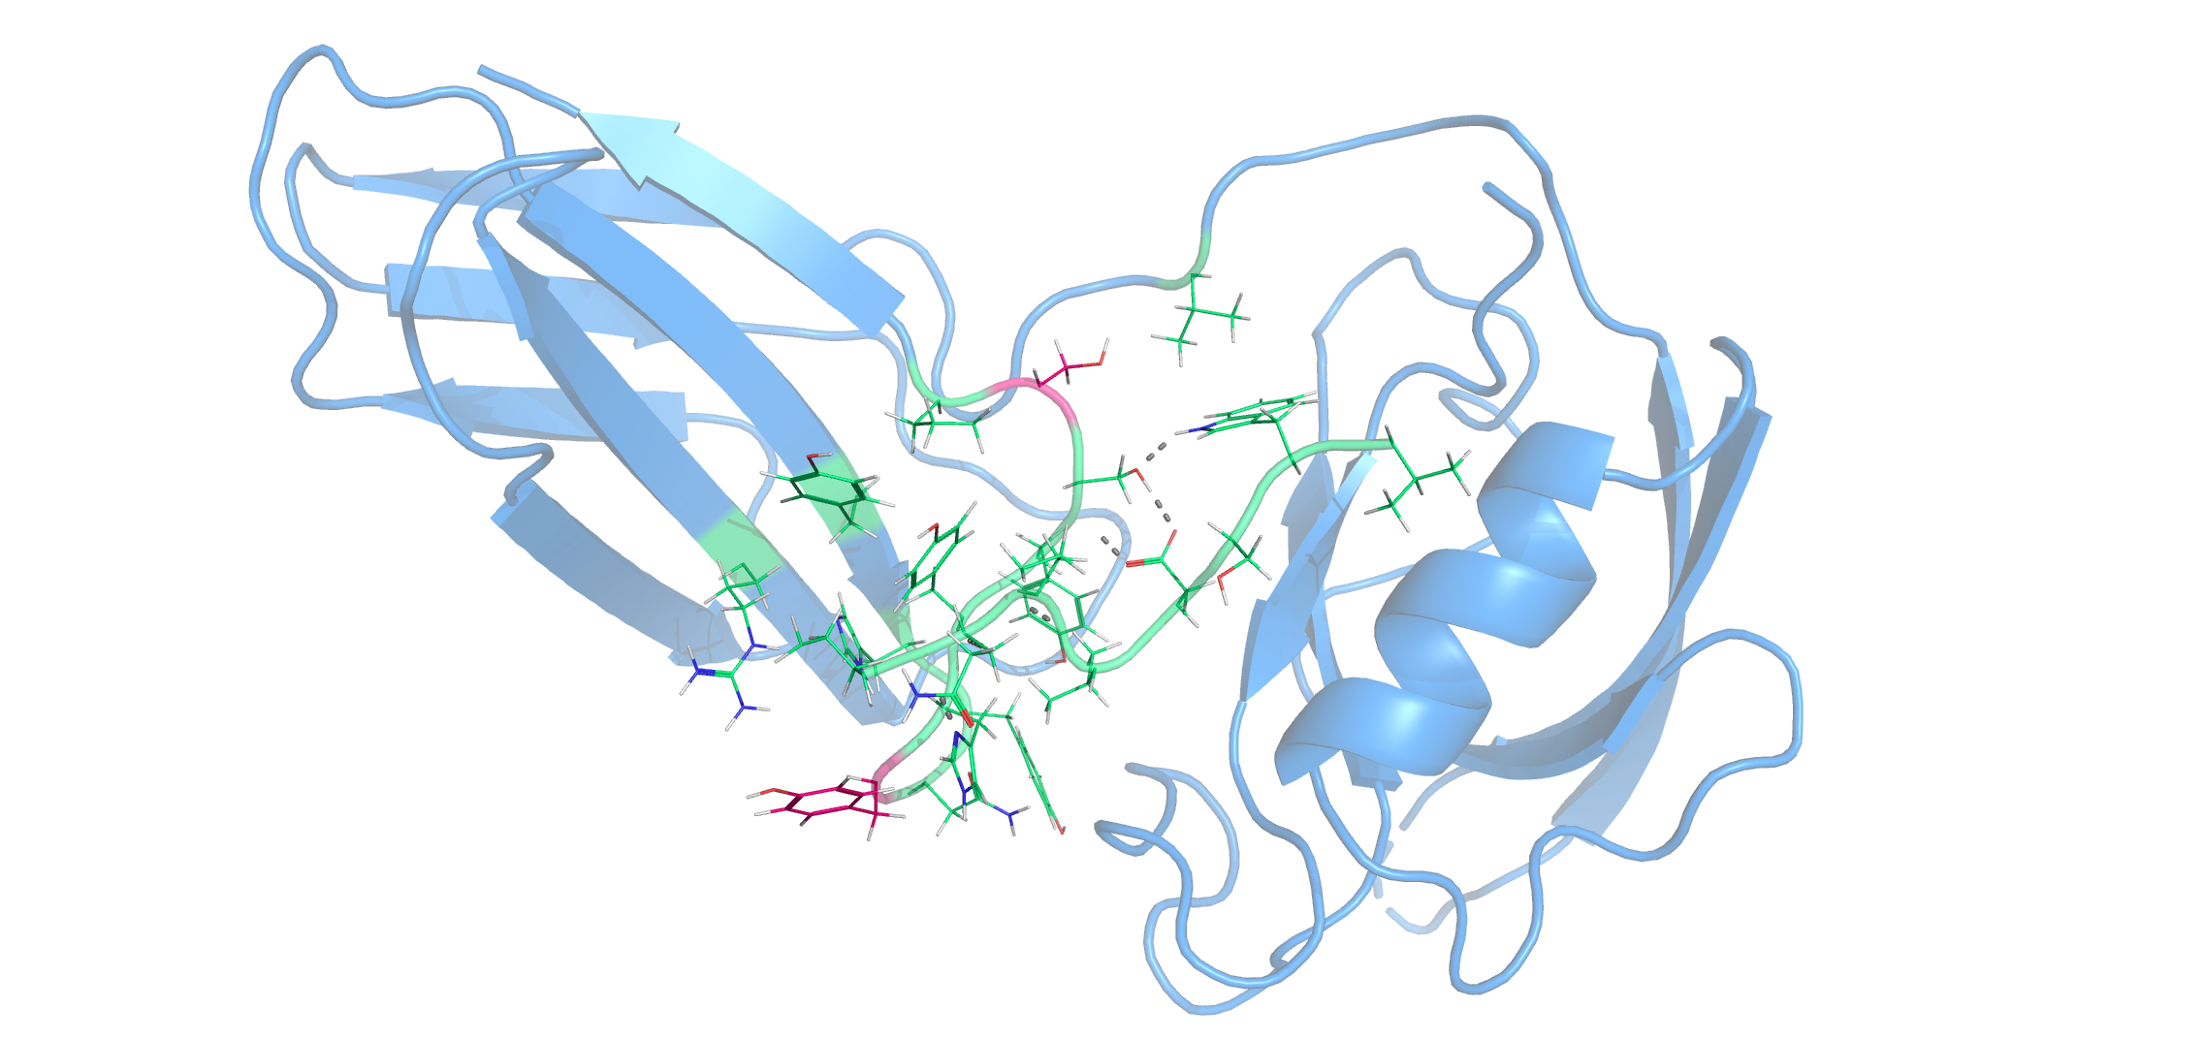
1. Relaxation
1000 3CH8 decoys
relax_791.pdb

Slide 10
1. Relaxation
1000 decoys
Clamshell
Clamshell
3CH8
3CH8
Interface (< 9 Angs)
Ligand

Slide 11
1. Relaxation

Slide 12
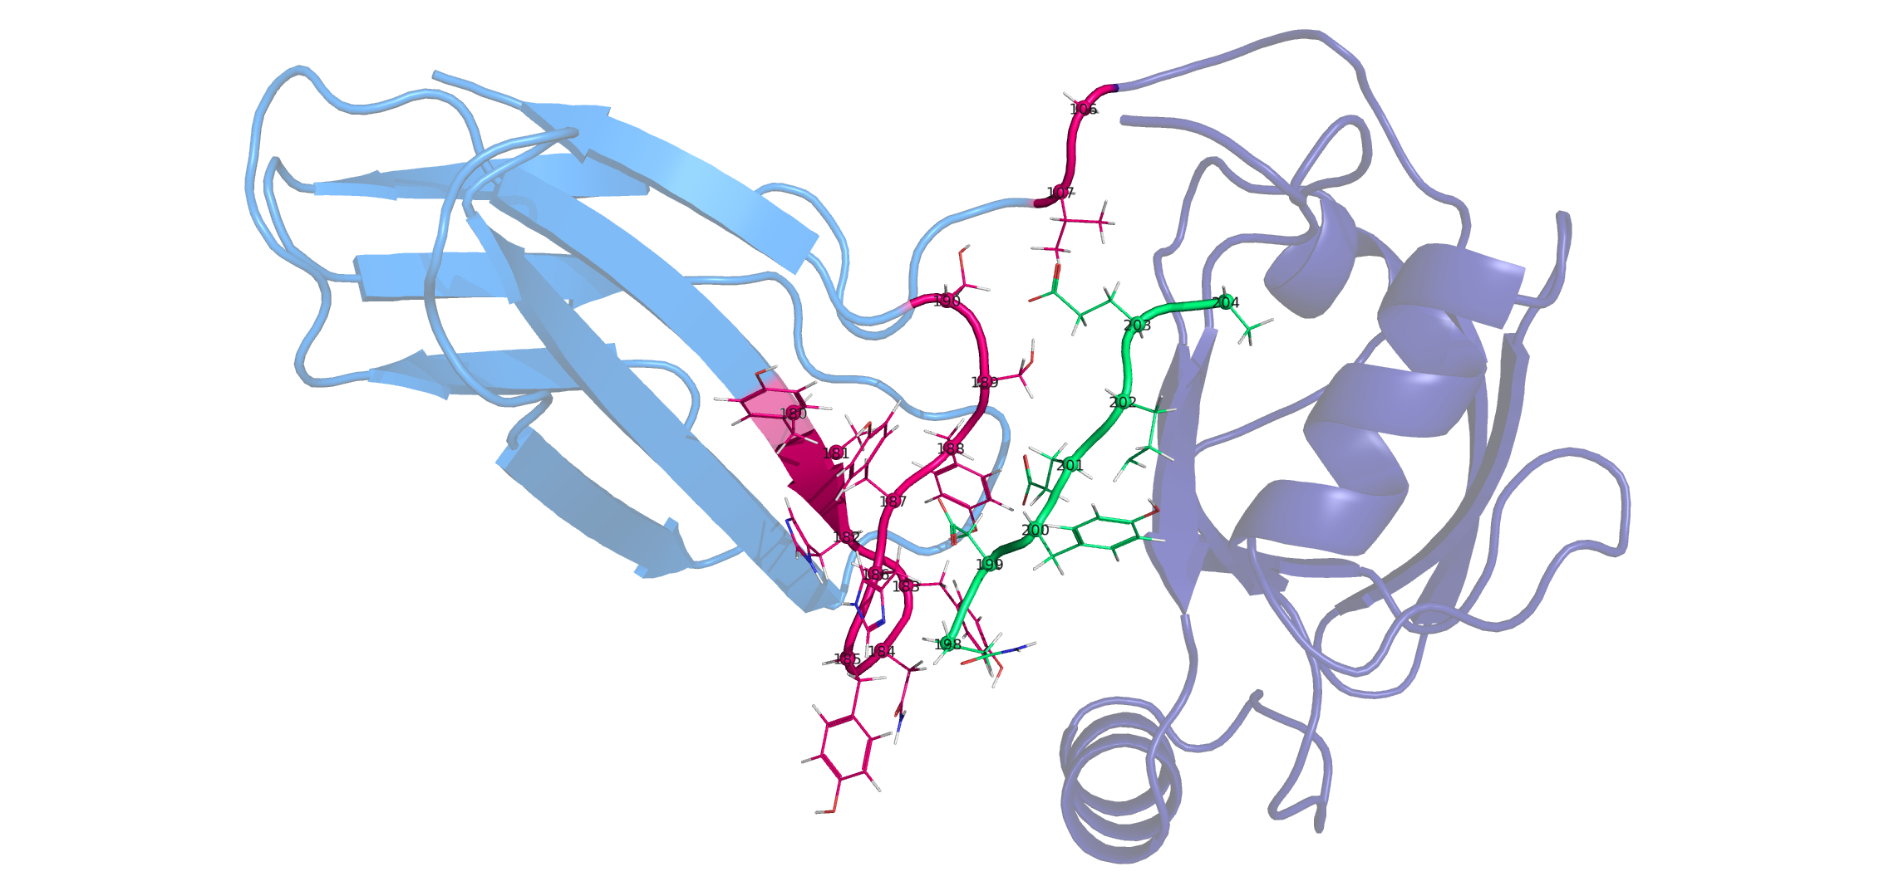
2. Design
Repack only
Interface selected for design
1000 decoys
Not considered for design
Interface (< 9 Angs)
Ligand

Slide 13
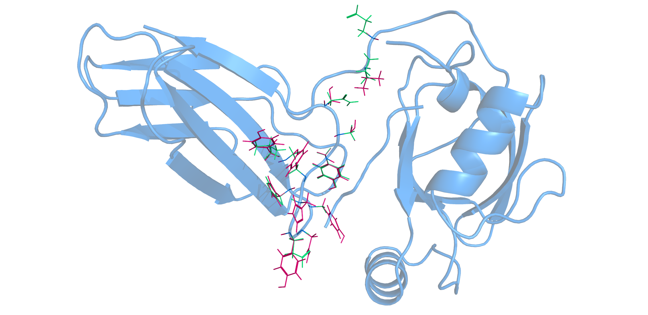
2. Design
1000 decoys (Top 10 hits have the same energy/sequence)
95.10% Sequence conserved | 977 BLOSUM62 Score

Slide 14
2. Design

Slide 15
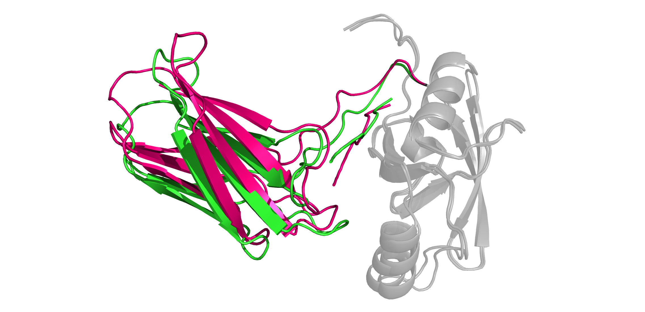
2. Design
The original position of the graft changed abruptly when relaxed without constraints
The clamshell graft seems to require a new position to adapt to this ligand

Slide 16
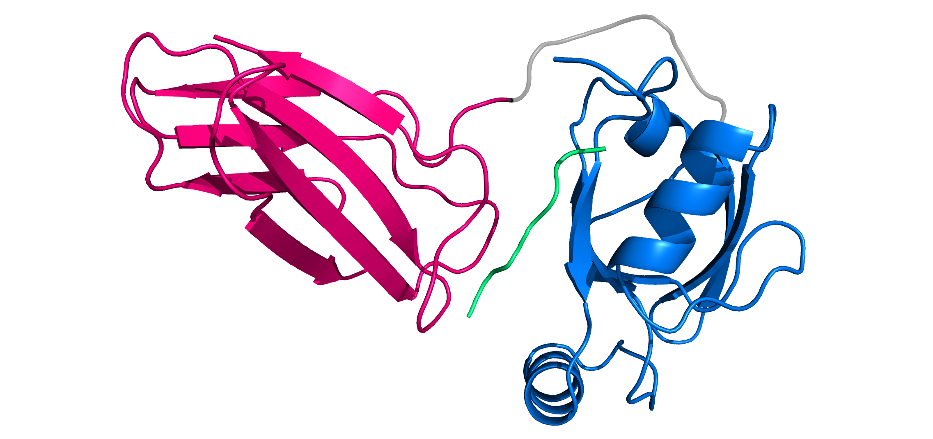
3. Multi docking design
Removed loop
Movable region
Fixed position region
(Used to define designable region)
Fixed position region

Slide 17
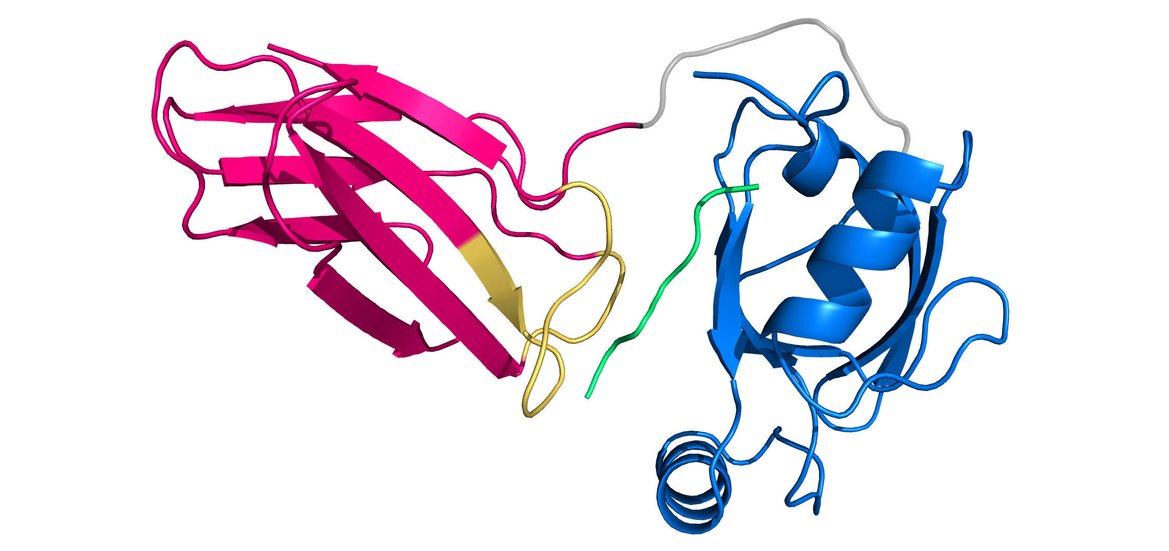
3. Multi docking design
Removed loop
Movable region
Designable region
Fixed position region
(Used to define designable region)
Fixed position region

Slide 18
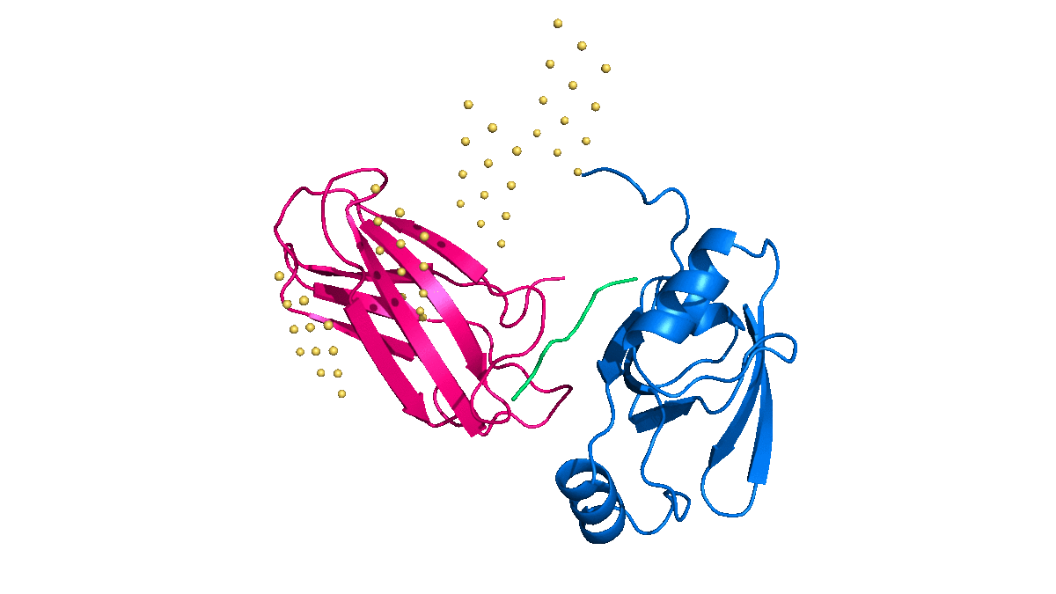
3. Multi docking design
Seed: Choose a starting position from a grid
Sampling: Random translation + rotation
Filter: Ignore non-promising position candidates
Design: Fixed backbone design + minimization

Slide 19
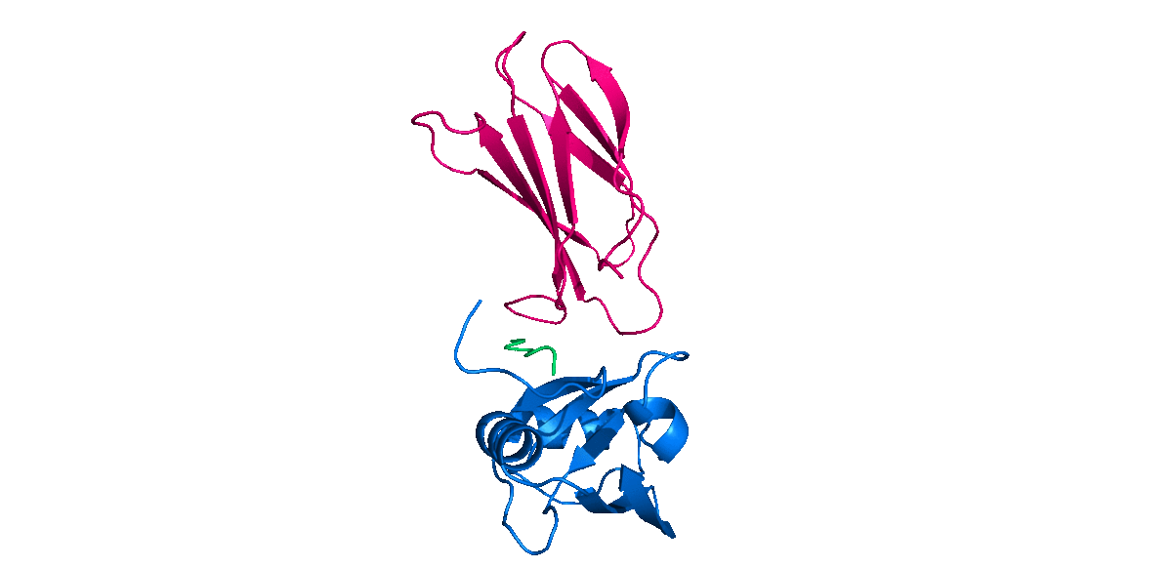
3. Multi docking design
Seed: Choose a starting position from a grid
Sampling: Random translation + rotation
Filter: Ignore non-promising position candidates
Design: Fixed backbone design + minimization

Slide 20
3. Multi docking design
Seed: Choose a starting position from a grid
Condition | Value employed
Number of clashes | Less than or equal to 2
Number of contacts | More than or equal to 10
Distance of the removed loop anchors | Less than or equal to 25 Å
Maximum interaction energy with ligand N terminal | Less than or equal to 0.05 REU
Sampling: Random translation + rotation
Filter: Ignore non-promising position candidates
Design: Fixed backbone design + minimization

Slide 21
3. Multi docking design
Design:
4 cycles of:
Design Interface
Repack ligand
Minimize sidechains
Seed: Choose a starting position from a grid
Sampling: Random translation + rotation
The multi docking design protocol was done on:
48 starting points/docks from a grid
250 decoys for each point/dock
1000 steps for each decoy
Total:
12 million position (and sequence) trials
72 to 96 hours of simulations
Filter: Ignore non-promising position candidates
Design: Fixed backbone design + minimization

Slide 22
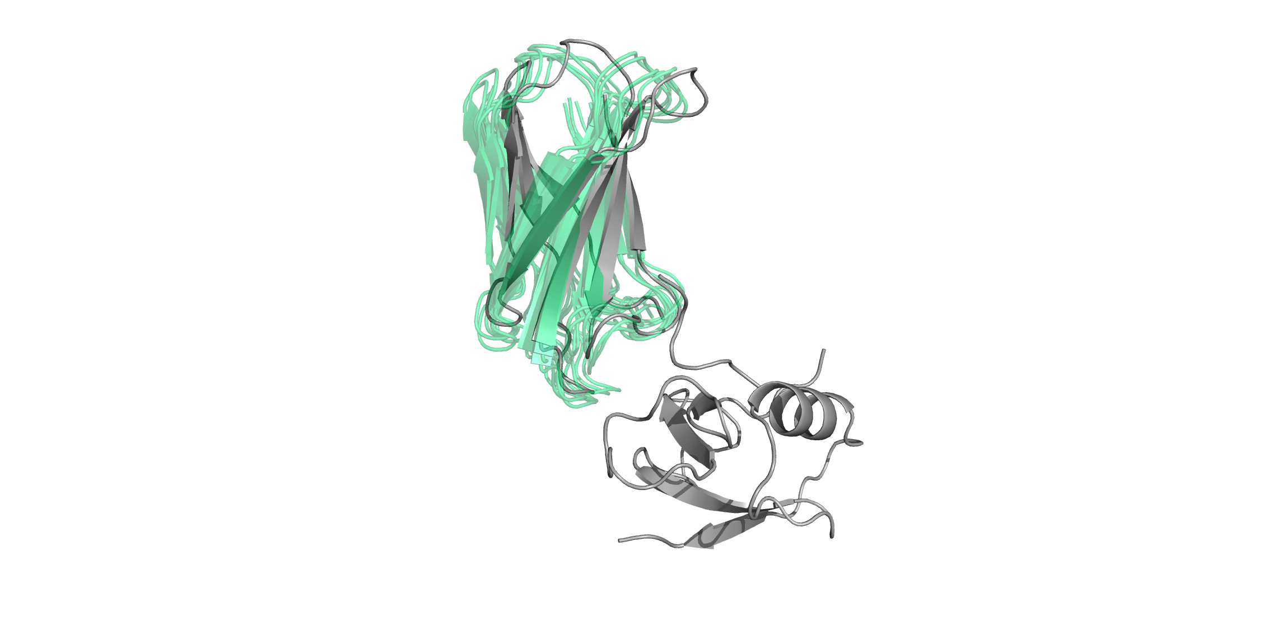
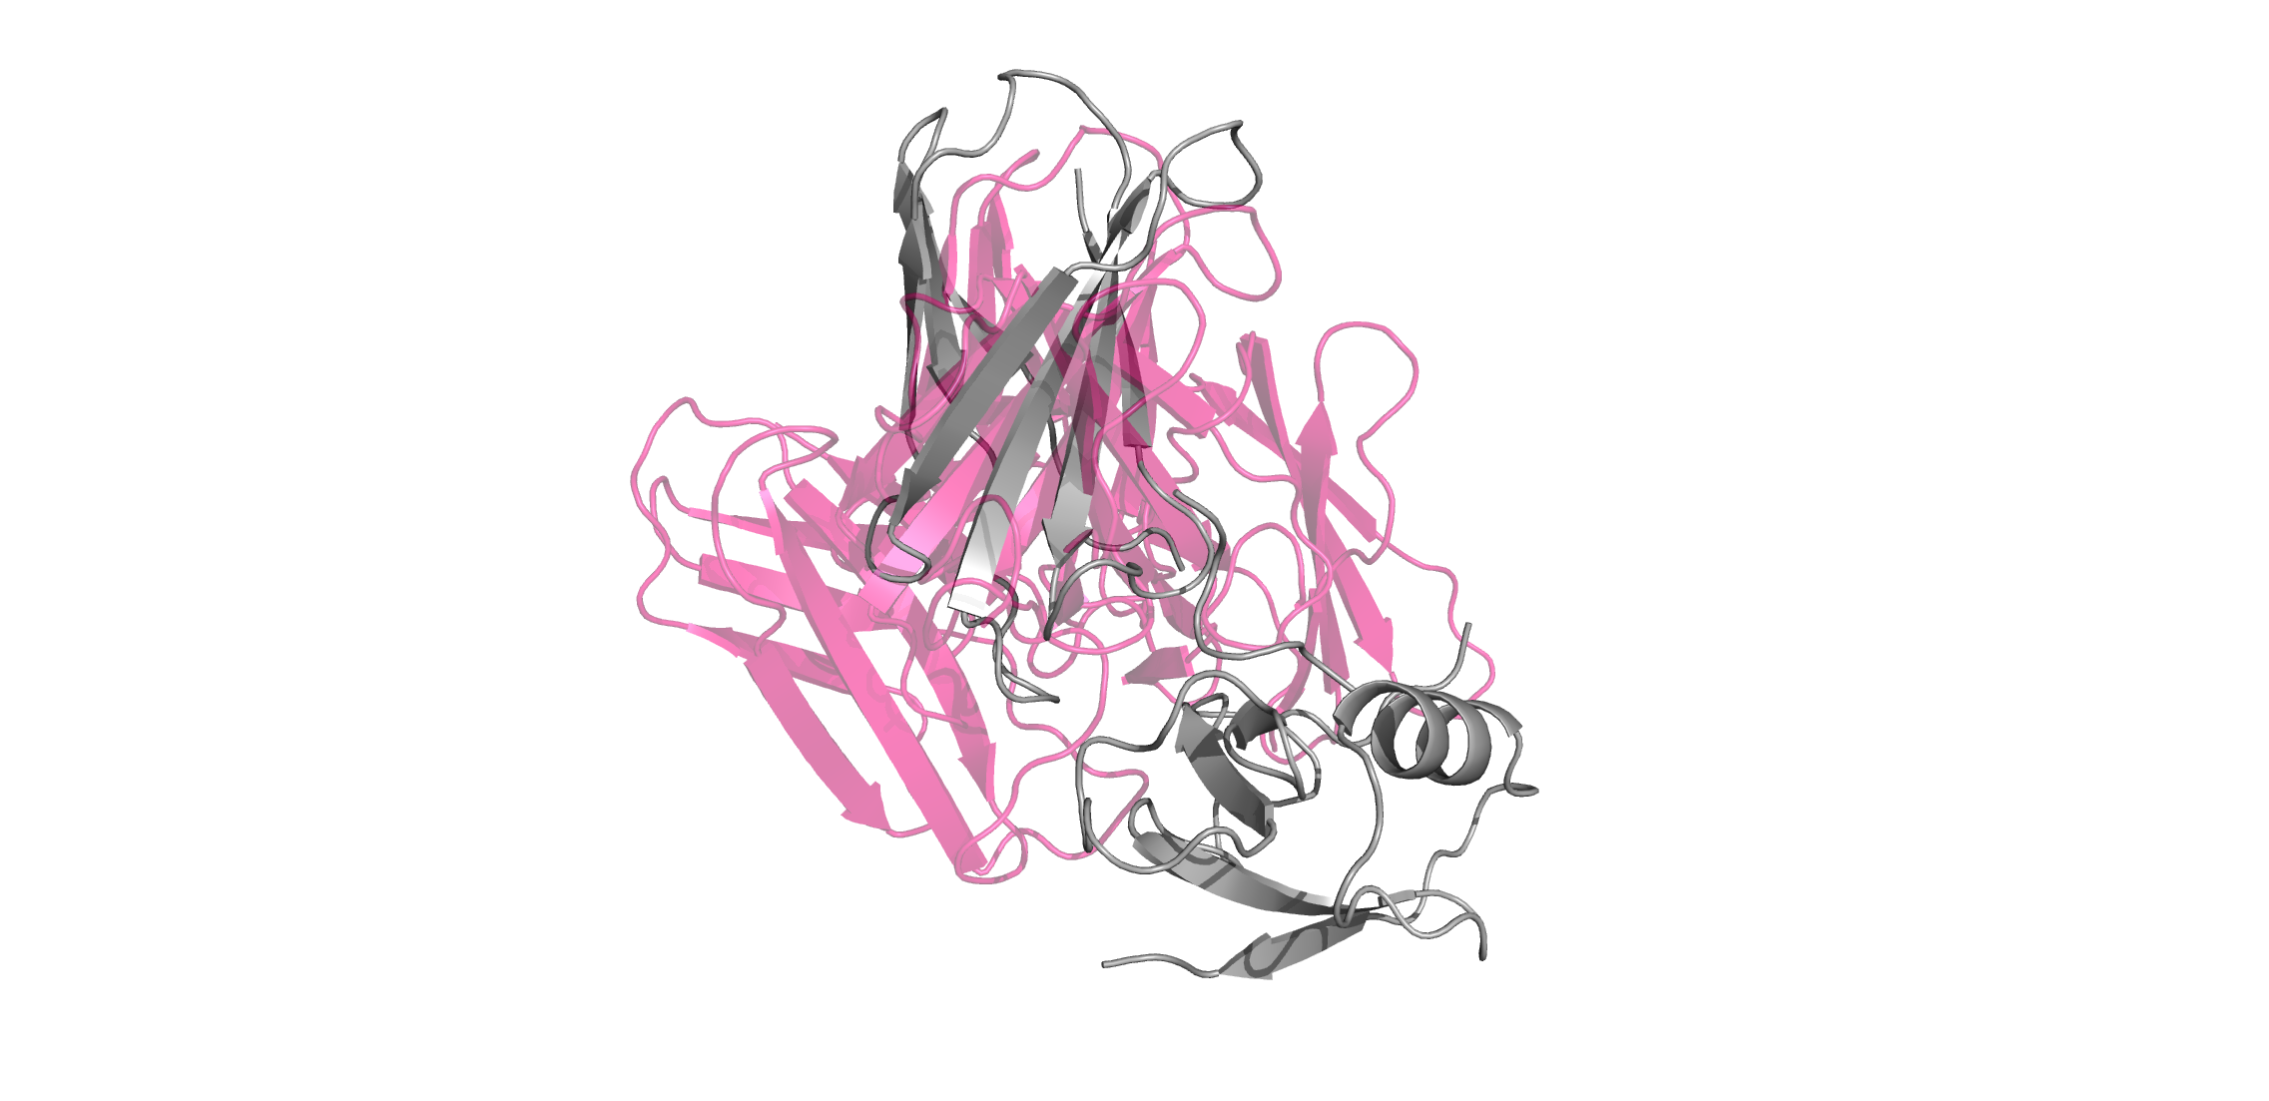
3. Multi docking design
Benchmarked on 3CH8
Top 5 low energy structures
Random high energy structures

Slide 23
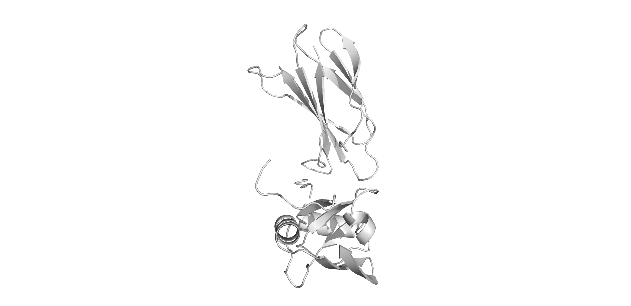
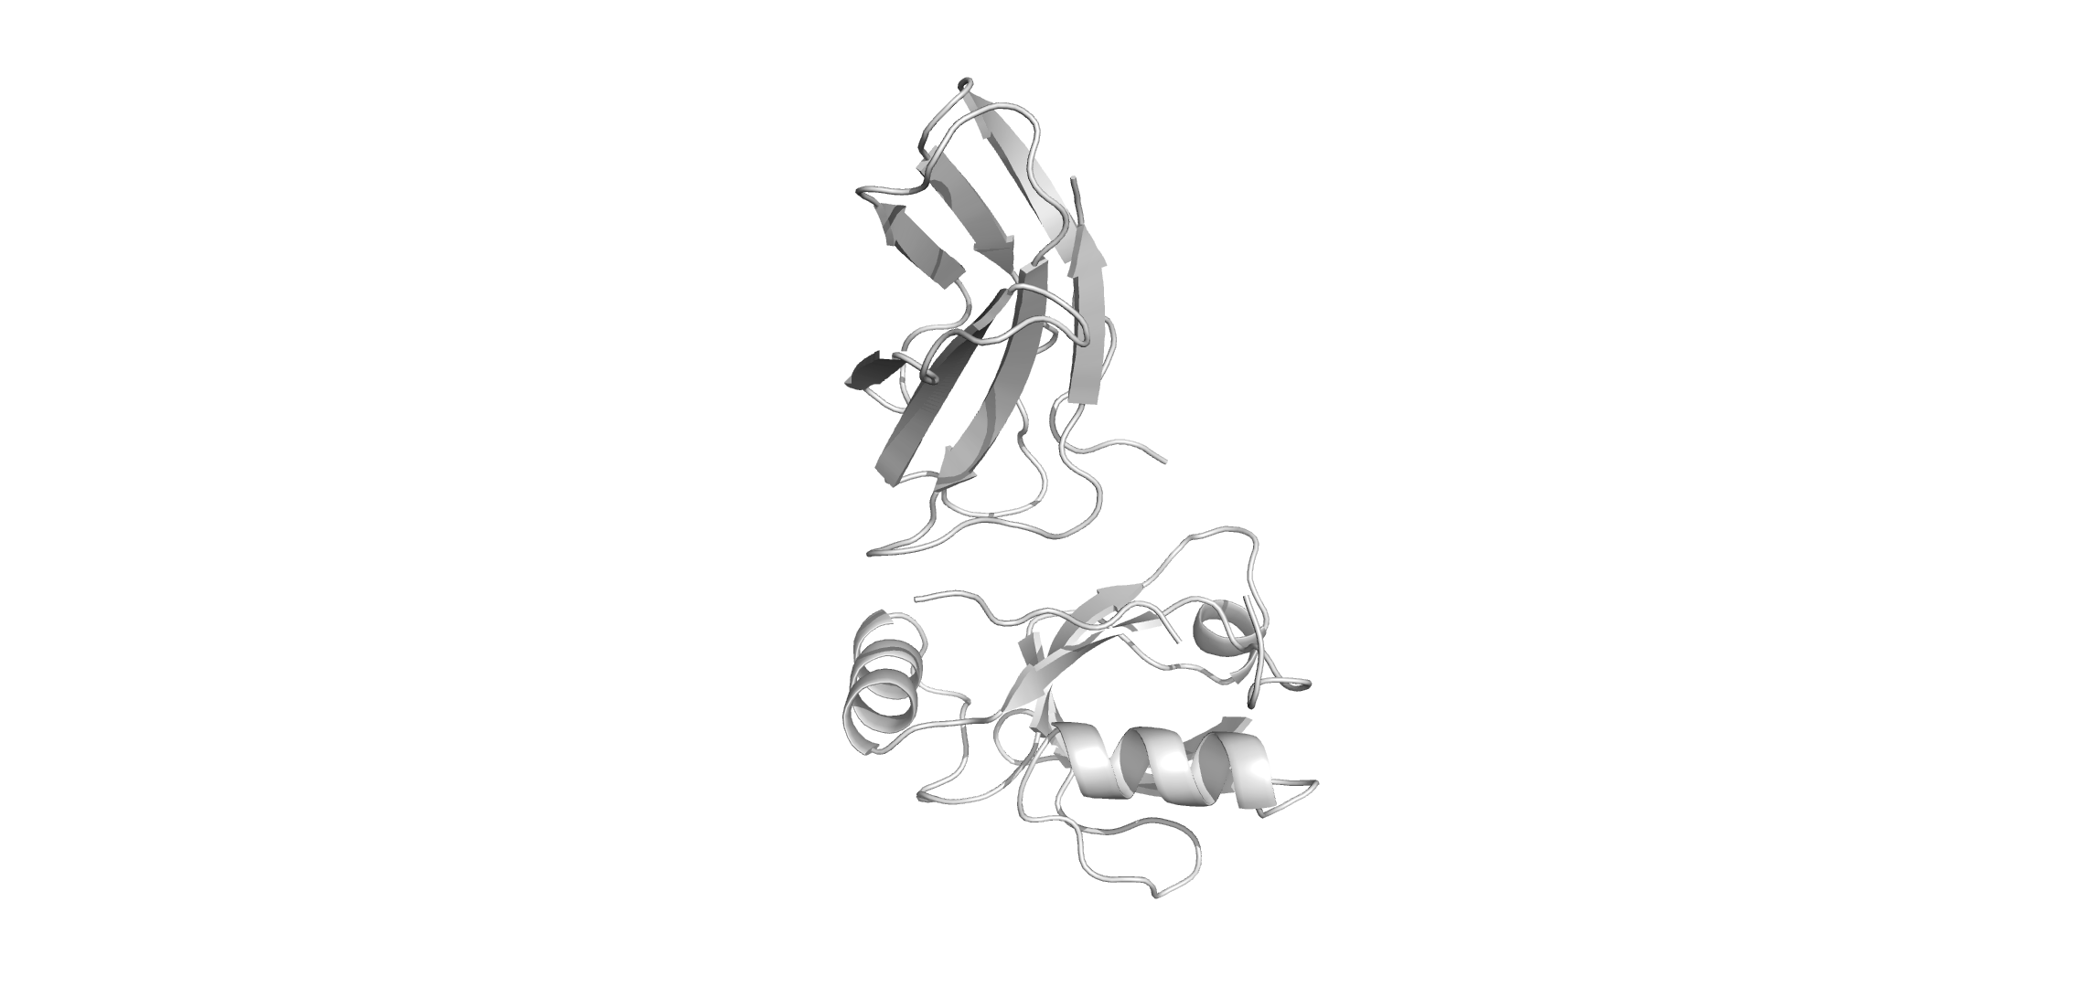
3. Multi docking design
Clamshell
* - Without the loop

Slide 24
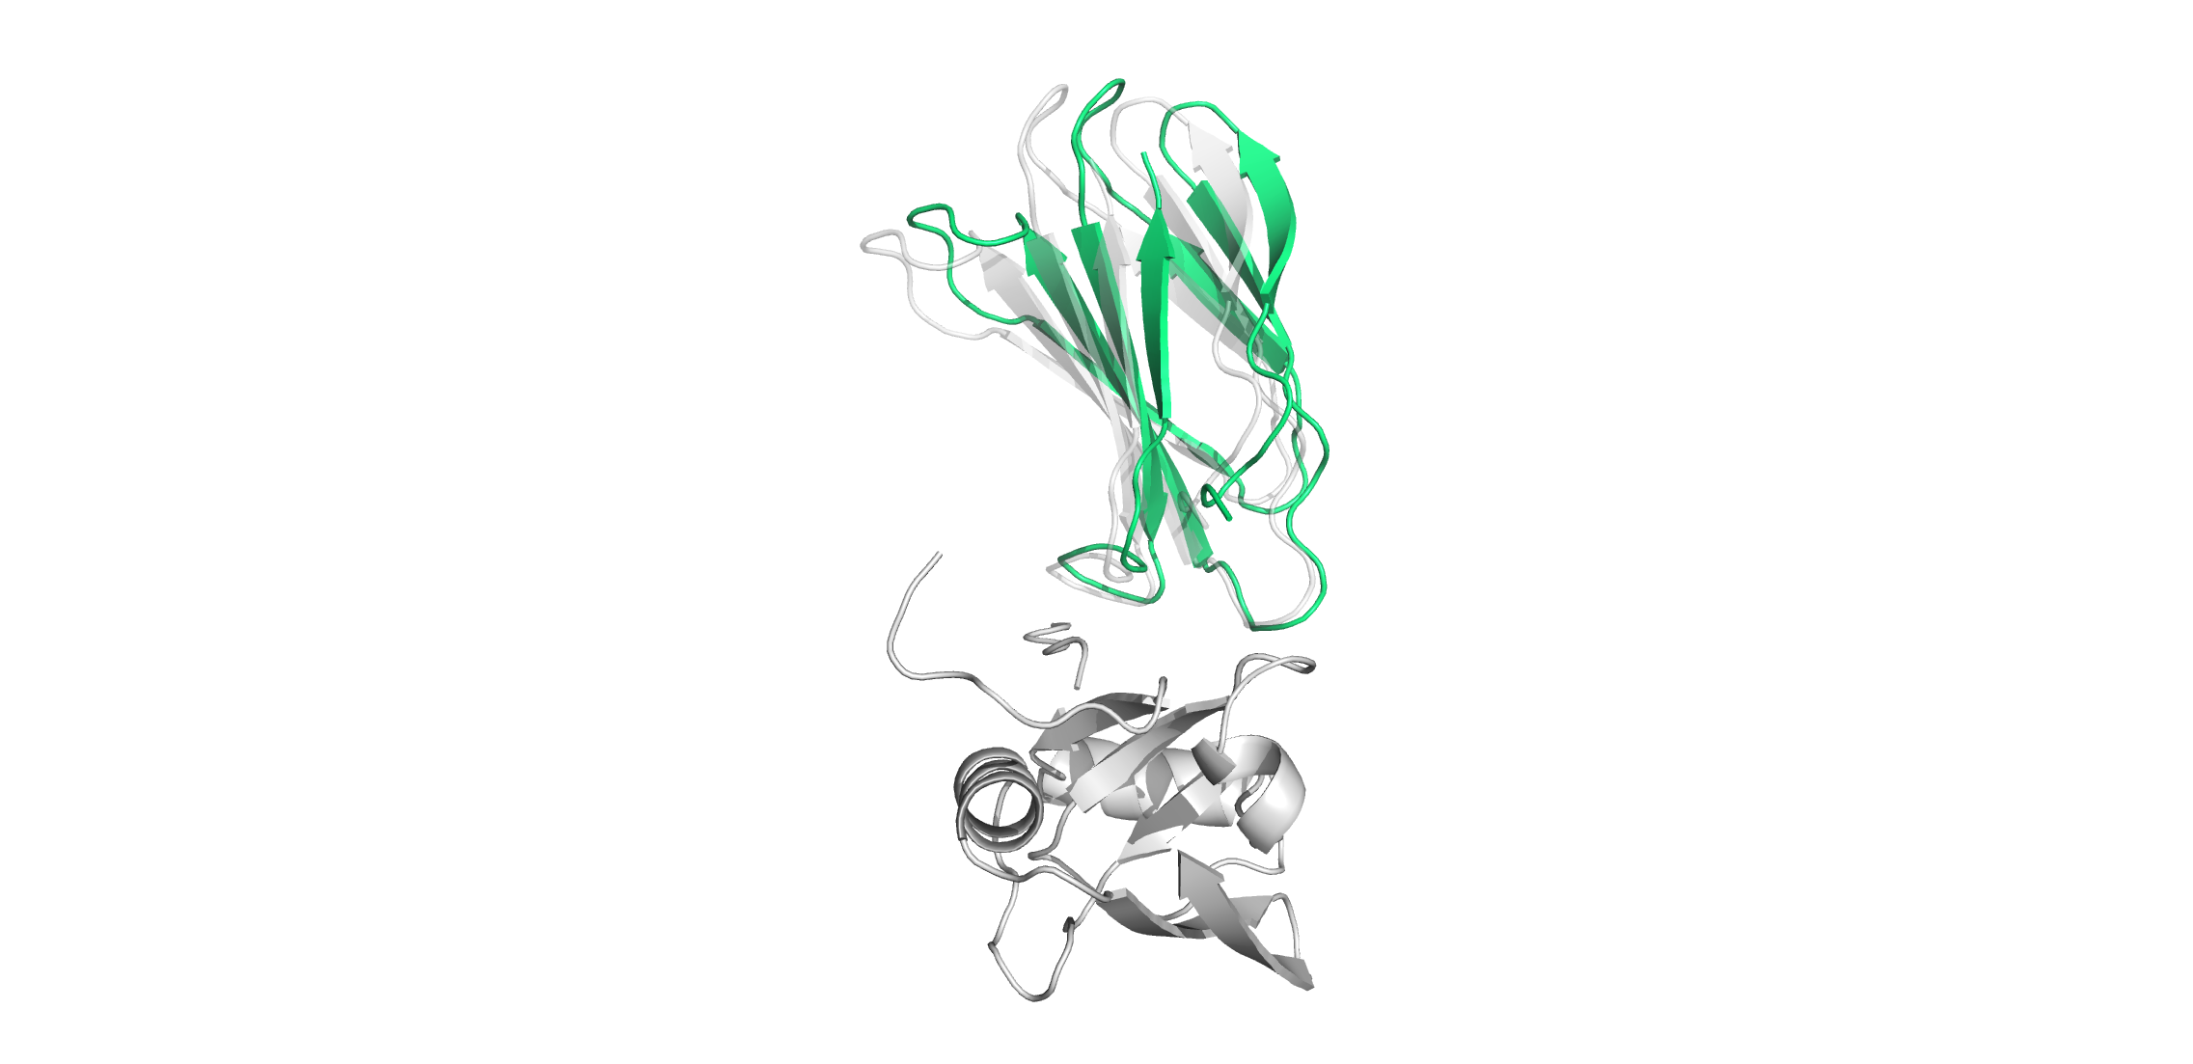
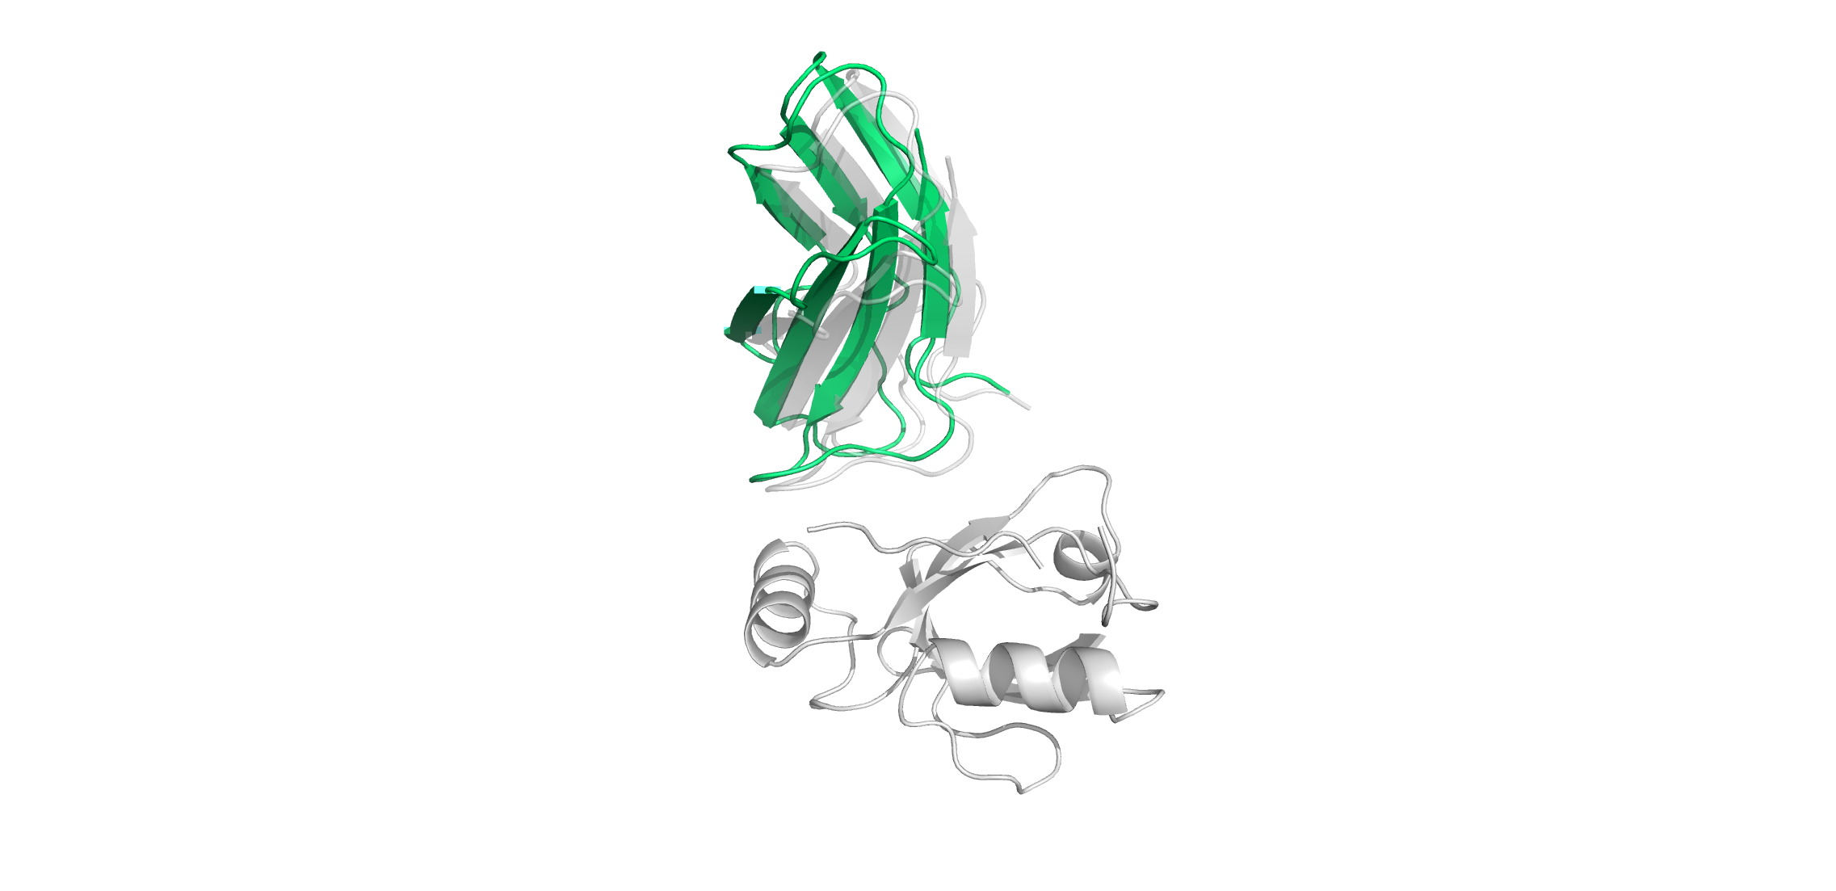
3. Multi docking design
Candidate 0_132_160

Slide 25
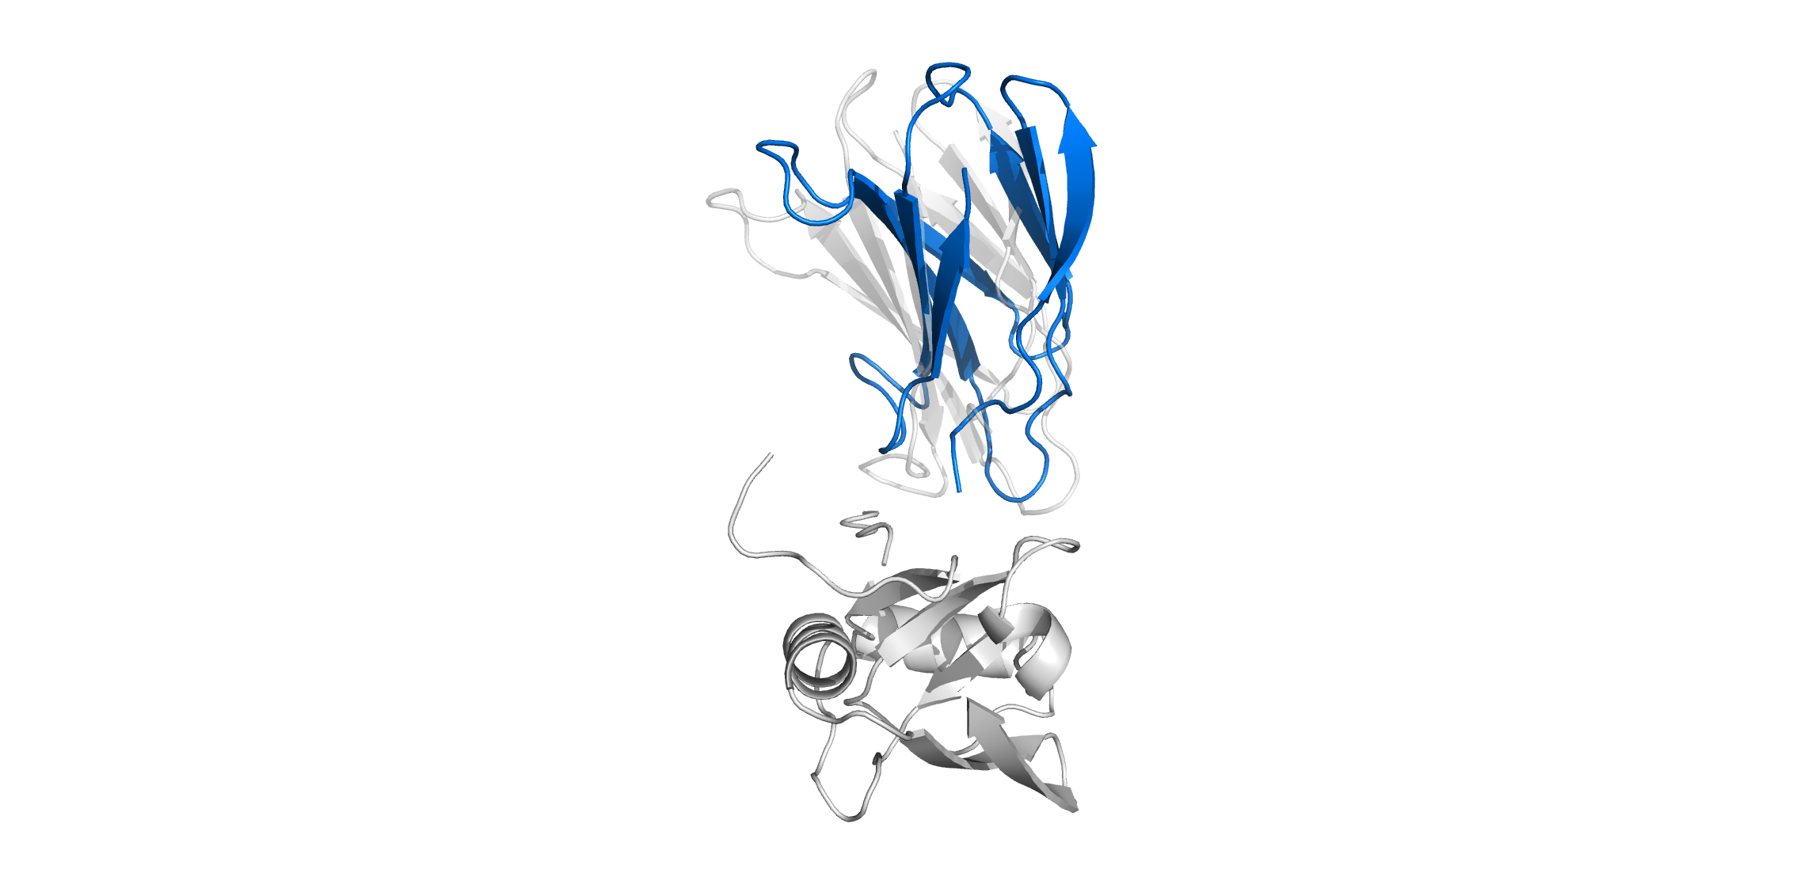
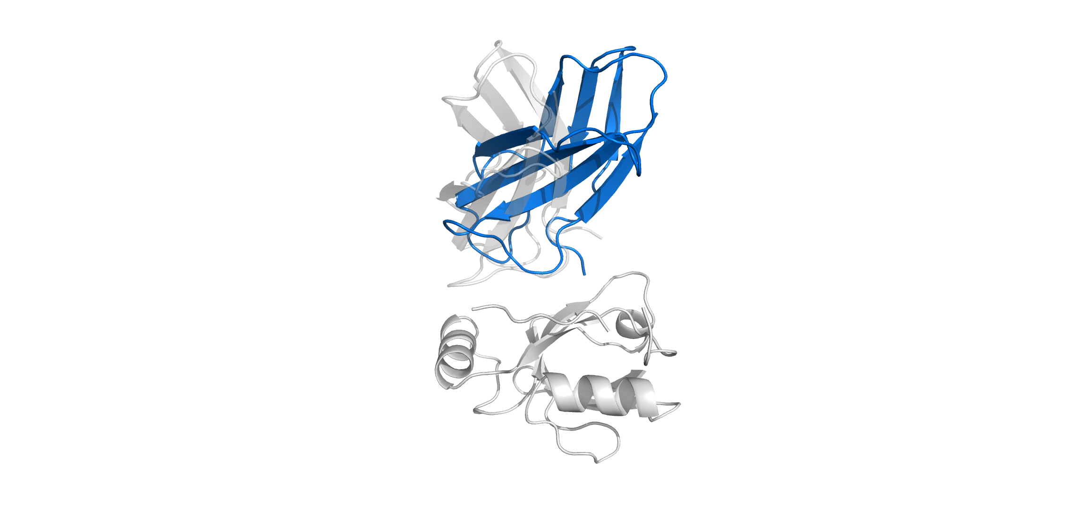
3. Multi docking design
Candidate 0_209_307

Slide 26
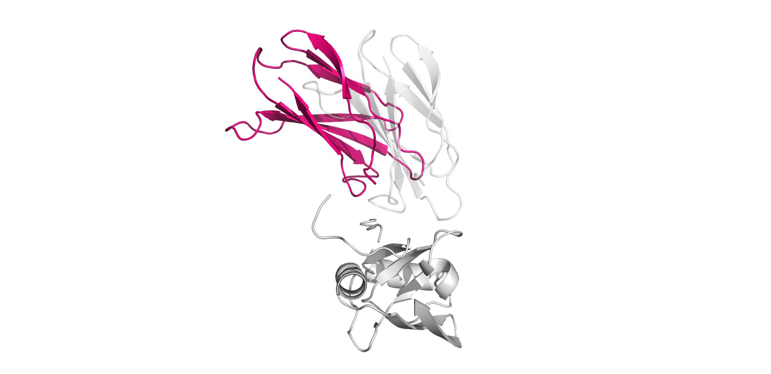
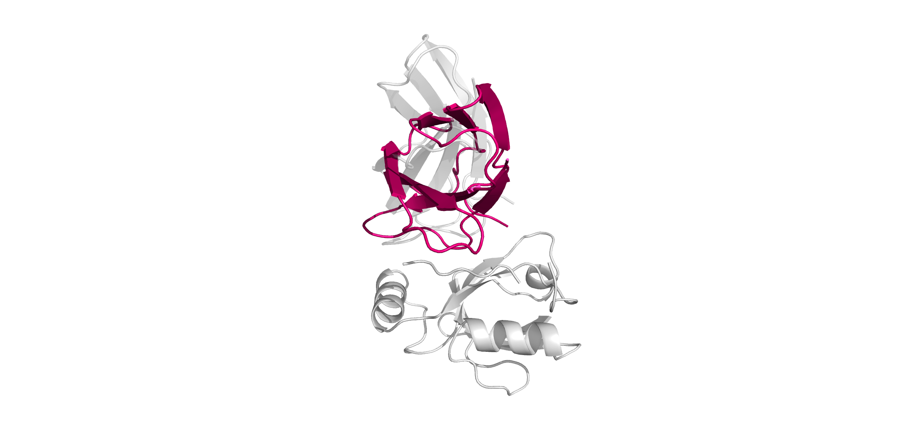
3. Multi docking design
Candidate 0_33_957

Slide 27
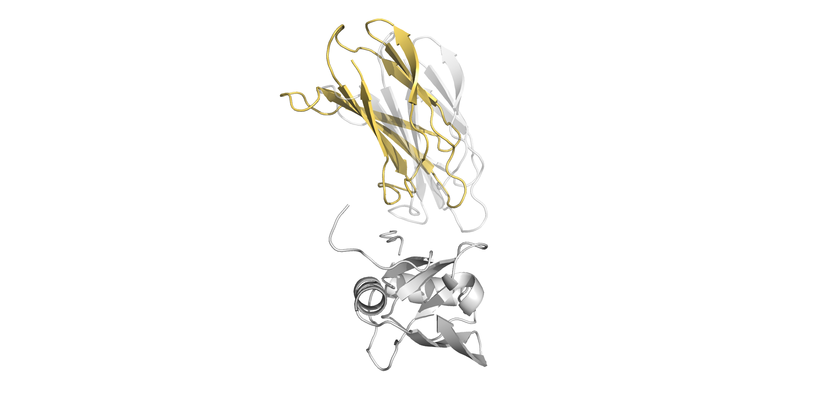
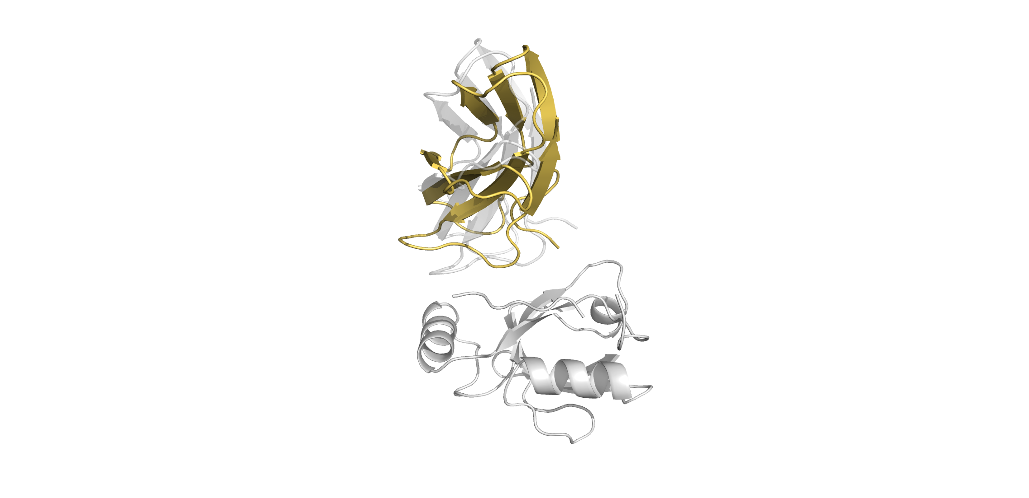
3. Multi docking design
Candidate 18_95_704

Slide 28
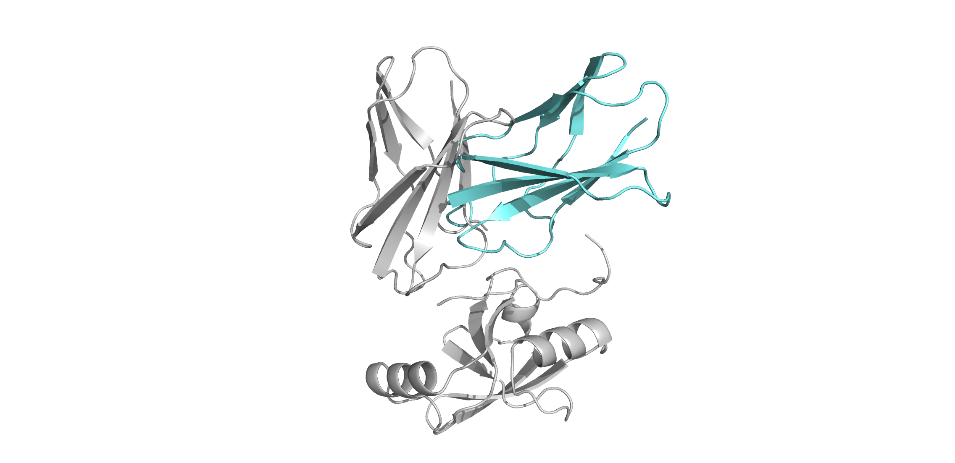
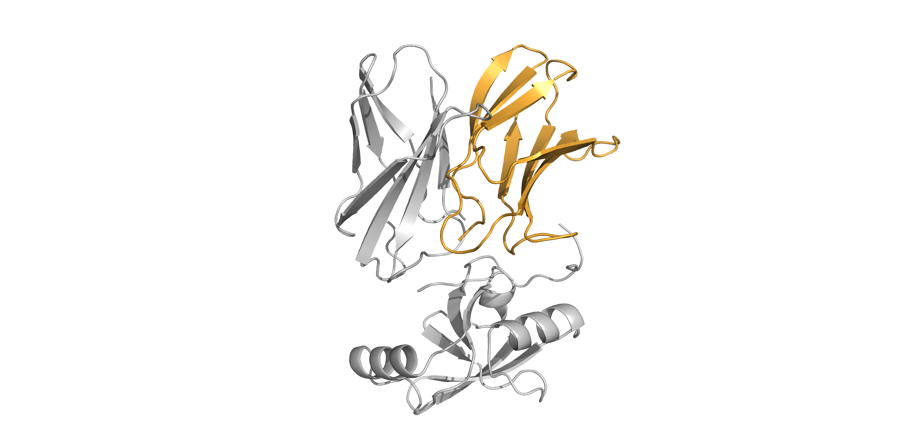
3. Multi docking design
Some interesting extremes were not considered.
Candidate 25_236_436
Total energy: -447.801 Interaction energy: -40.281
Candidate 35_110_760
Total energy: -494.170 Interaction energy: -25.438

Slide 29
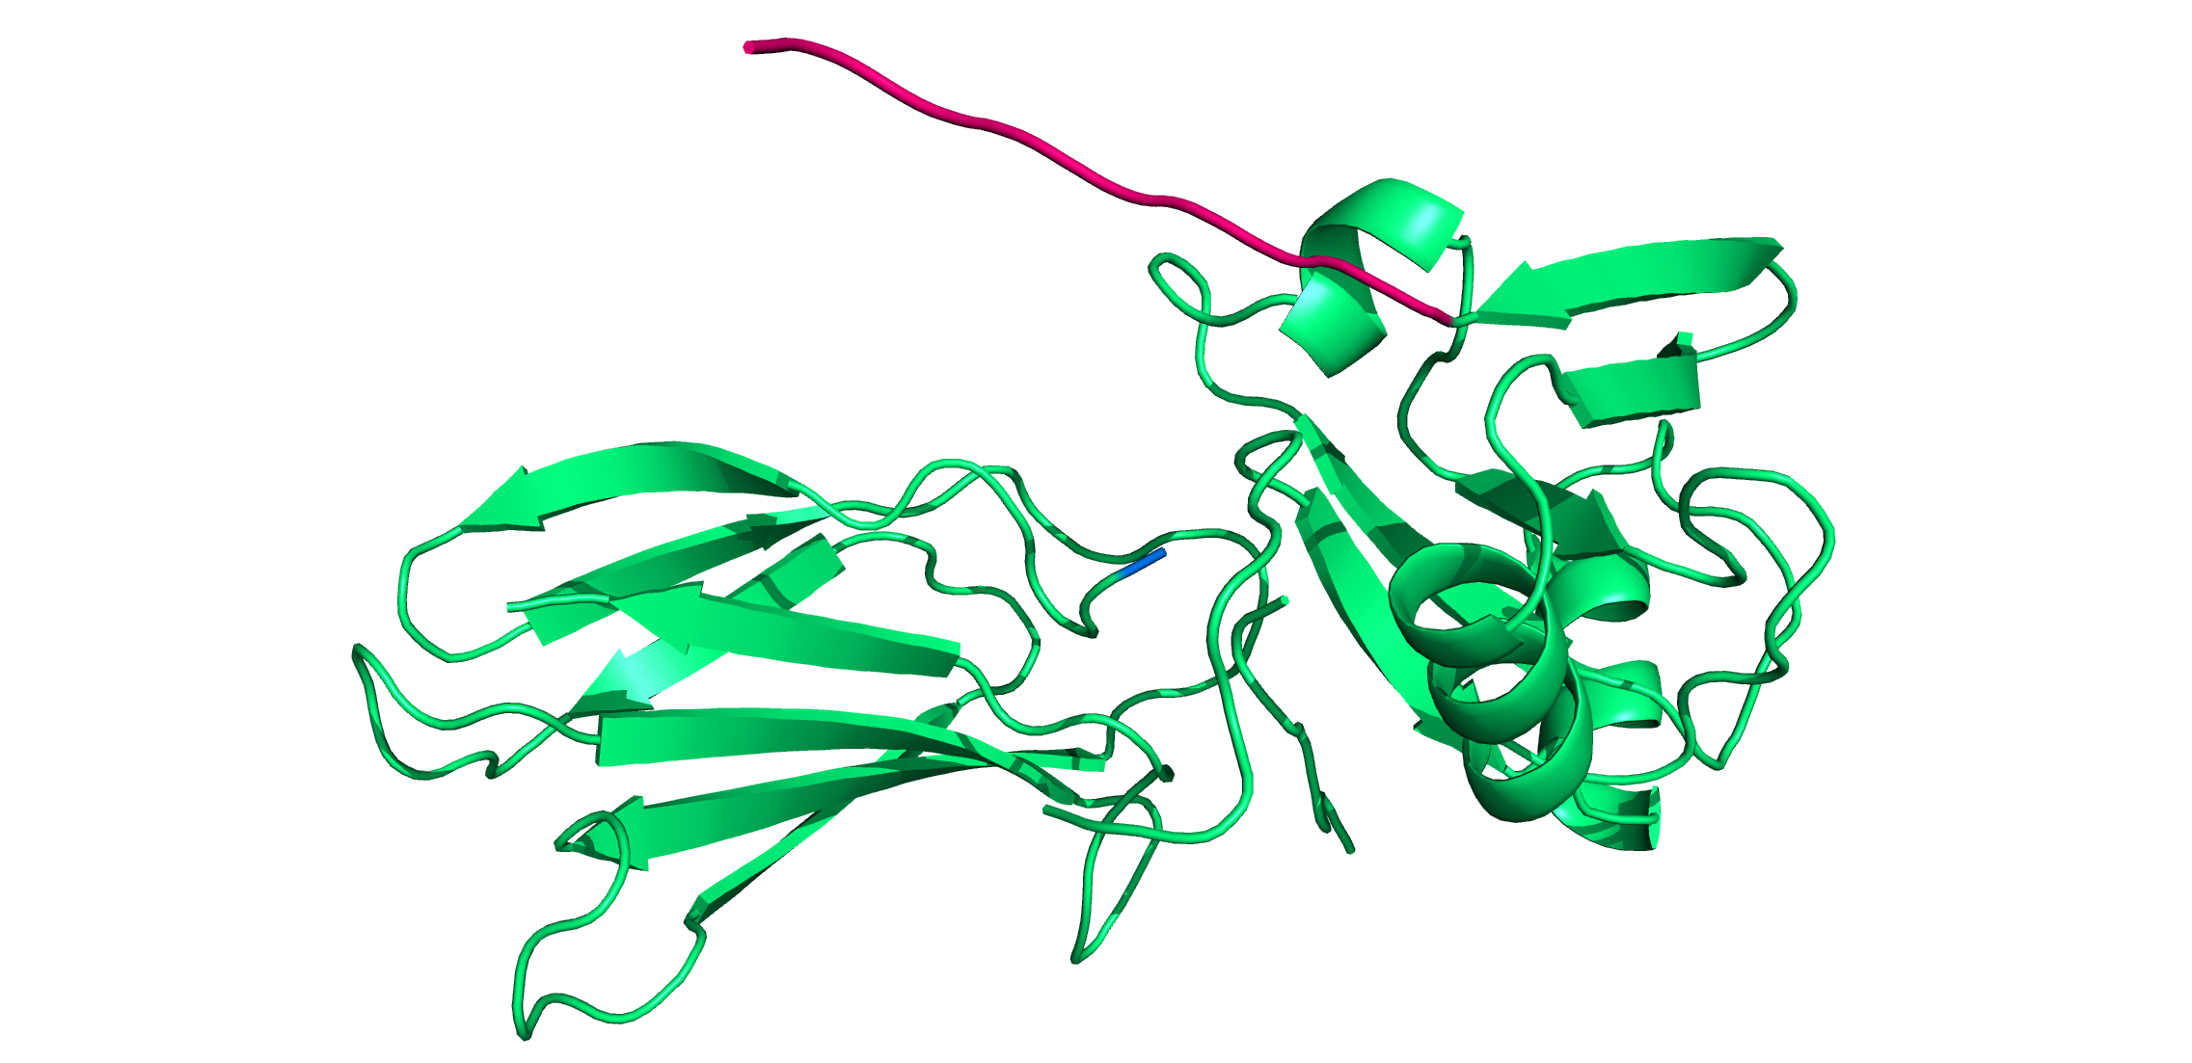
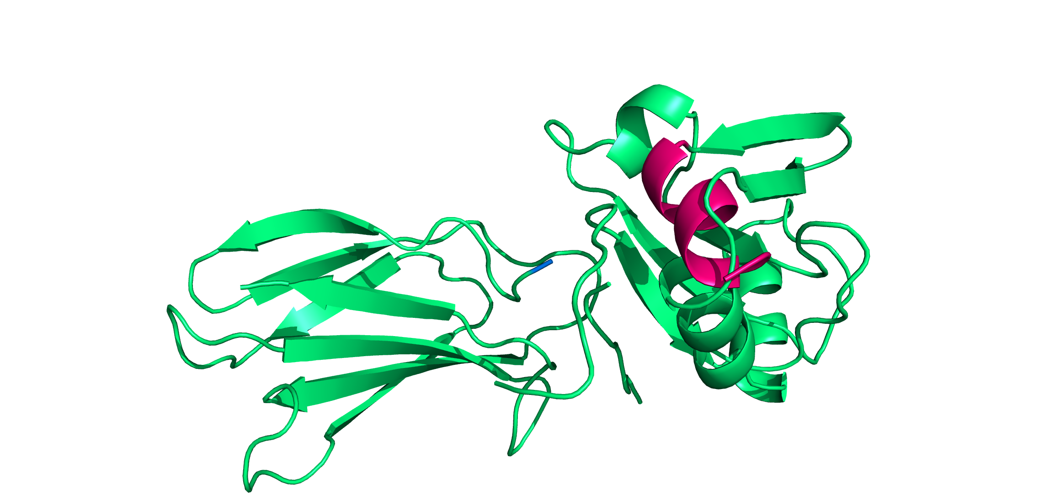
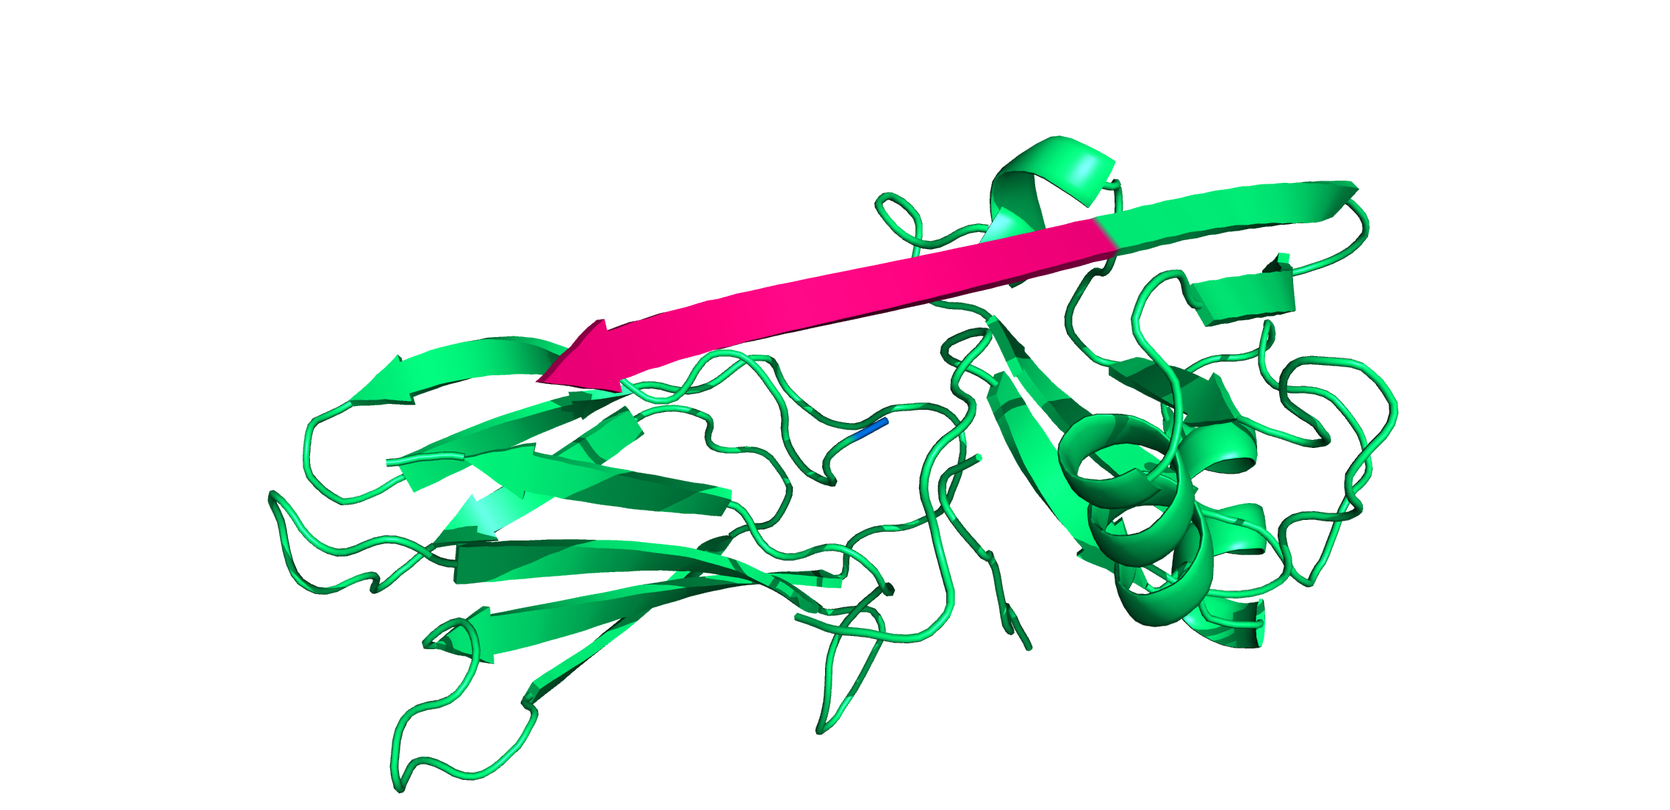
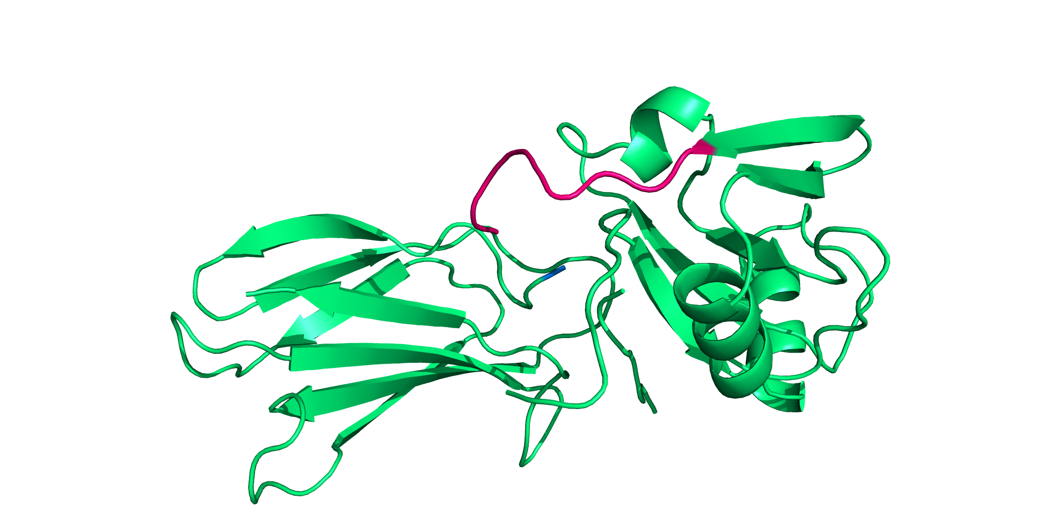
4. Recreating the loop
In a stretched conformation
As an alpha helix
In the original conformation
As a beta sheet

Slide 30
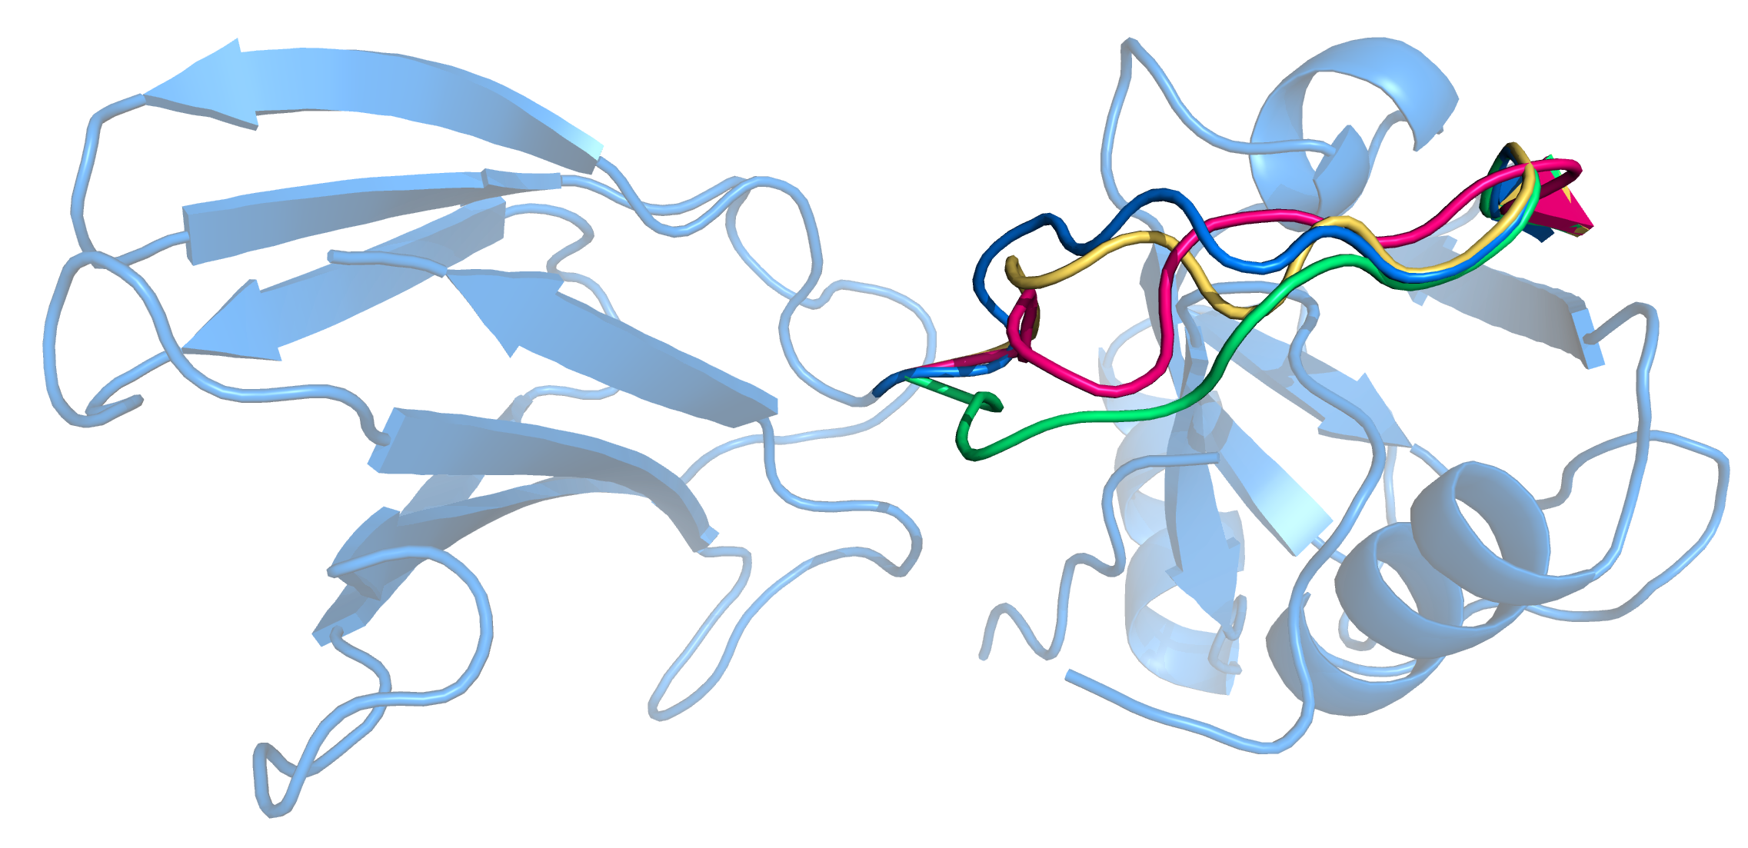
4. Recreating the loop
20 decoys (Currently performing on 1000 decoys)
Candidate 0_209_307_6
Candidate 0_209_307_3
Candidate 0_209_307_19
Candidate 0_209_307_17

Slide 31
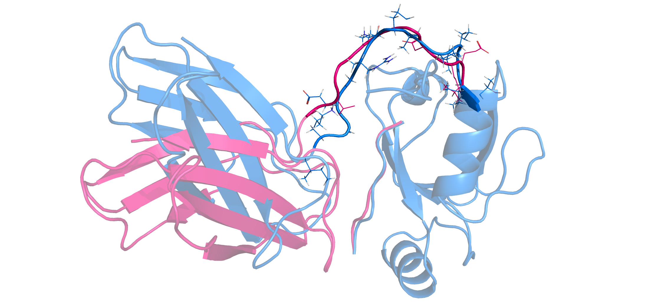
4. Recreating the loop
Recreated loop for candidate 0_209_307_6
Original clamshell

Slide 32
4. Recreating the loop

Slide 33
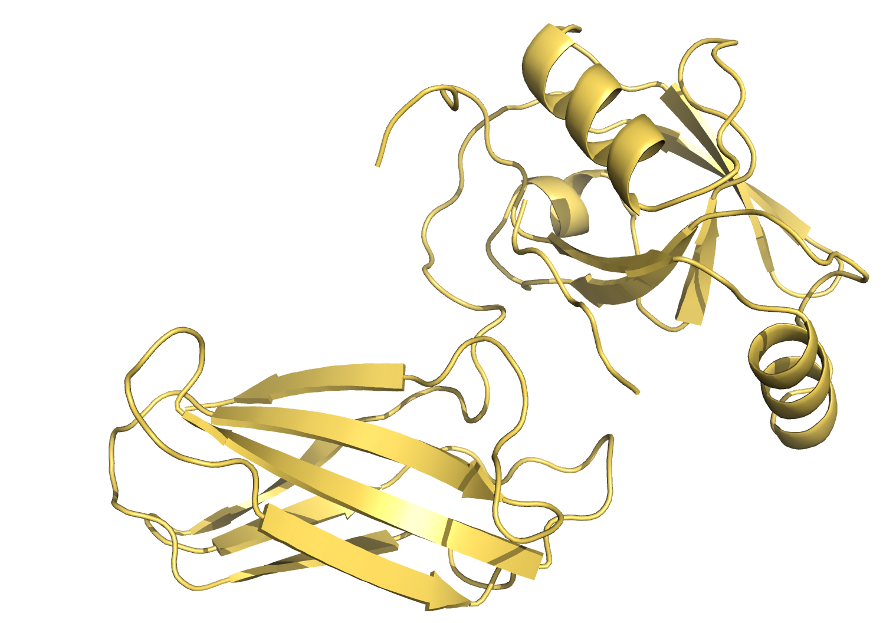
Some conclusions
The proposed protocol for grafting two parts into a single protein seems to work as intended.
The objective of the protocol is to efficiently explore the vast conformational space for the simultaneous optimization of the position and sequence of a new graft.
A library of candidate sequences has been created.
In comparison to the original relaxed structure, some candidates show:
16-17% improvement rates in terms of overall energy;
350-360% improvement rates in terms of interaction energy.

Slide 34
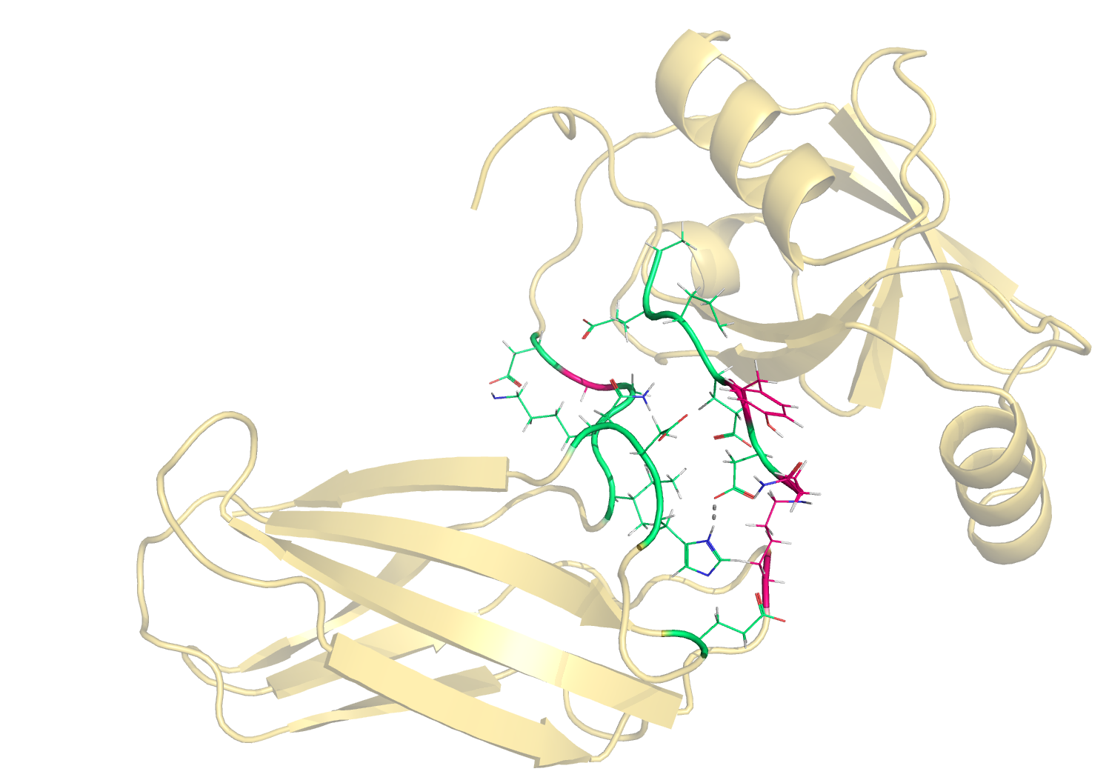
Some conclusions
The proposed protocol for grafting two parts into a single protein seems to work as intended.
The objective of the protocol is to efficiently explore the vast conformational space for the simultaneous optimization of the position and sequence of a new graft.
A library of candidate sequences has been created.
In comparison to the original relaxed structure, some candidates show:
16-17% improvement rates in terms of overall energy;
350-360% improvement rates in terms of interaction energy.
The full code is made available at: github.com/JosePereiraUA/rosetta-scripts/

Slide 35
Some future work suggestions
Further improvements of the proposed protocol, as suggested by Prof. Sagar Khare:
Pick a spot on the grid
Random perturbation
Pass through filter
Pass through filter

Slide 36
Some future work suggestions
Further improvements of the proposed protocol, as suggested by Prof. Sagar Khare:
Pick a spot on the grid
Random perturbation
Pass through filter
Design target interactions in rationally picked aminoacids, by exploring all possible rotamers (4 to 5 residues)
Lock this conformations in a second design round

Slide 37

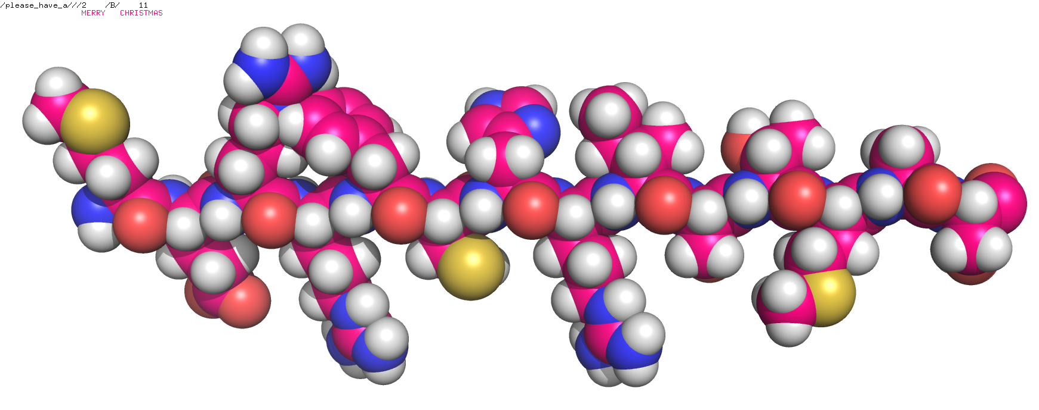
Thank you
Prof. Sagar Khare
Joey
All of you for your hospitality
And a happy new year!

